Slide 1
Bayes-TrEx: A Bayesian Sampling Approach to Transparency by Example
Serena Booth*
Yilun Zhou*
Ankit Shah
Julie Shah
AAAI 2021
Notes:
Hi! I’m Serena, and today I’m introducing Bayes-TrEx, a Bayesian sampling approach to transparency by example.

Slide 2
Consider a Corgi/Bread Classifier
Notes:
consider a Corgi/Bread classifier.
Images scraped from Flickr

Slide 3
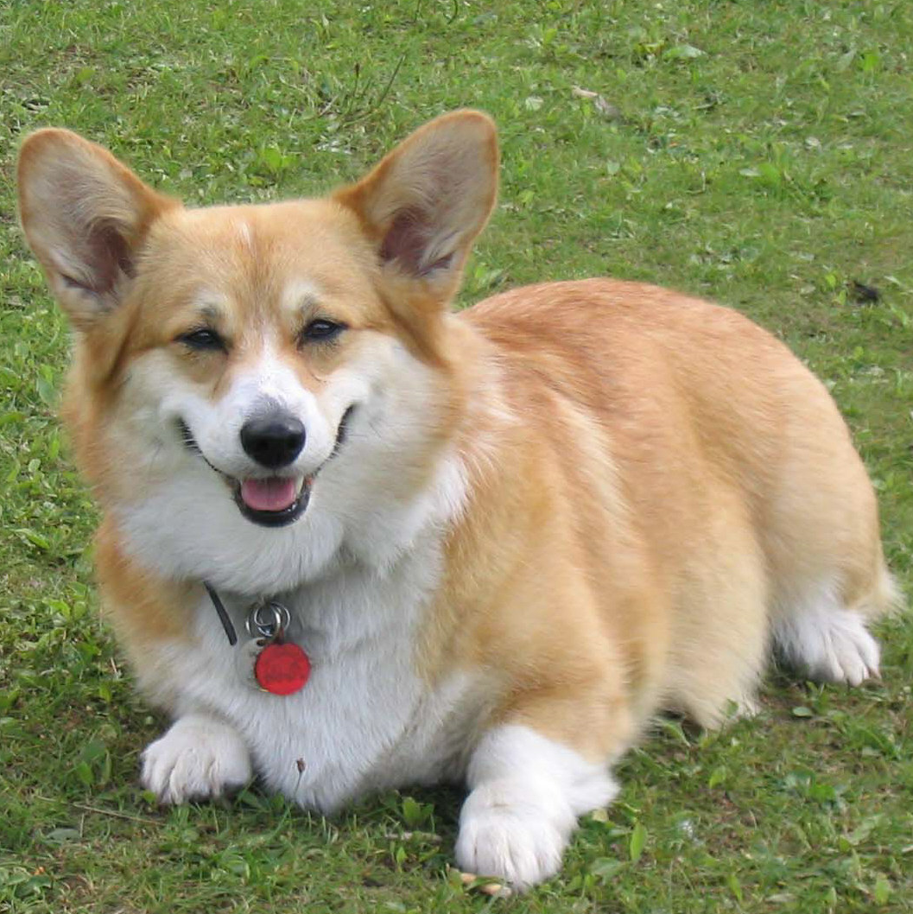
Consider a Corgi/Bread Classifier
Notes:
This classifier is trained on corgis
Images scraped from Flickr

Slide 4
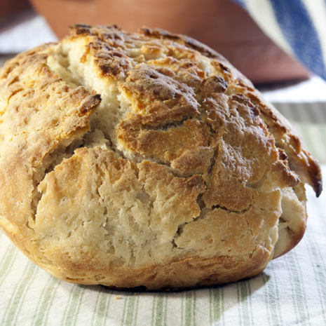
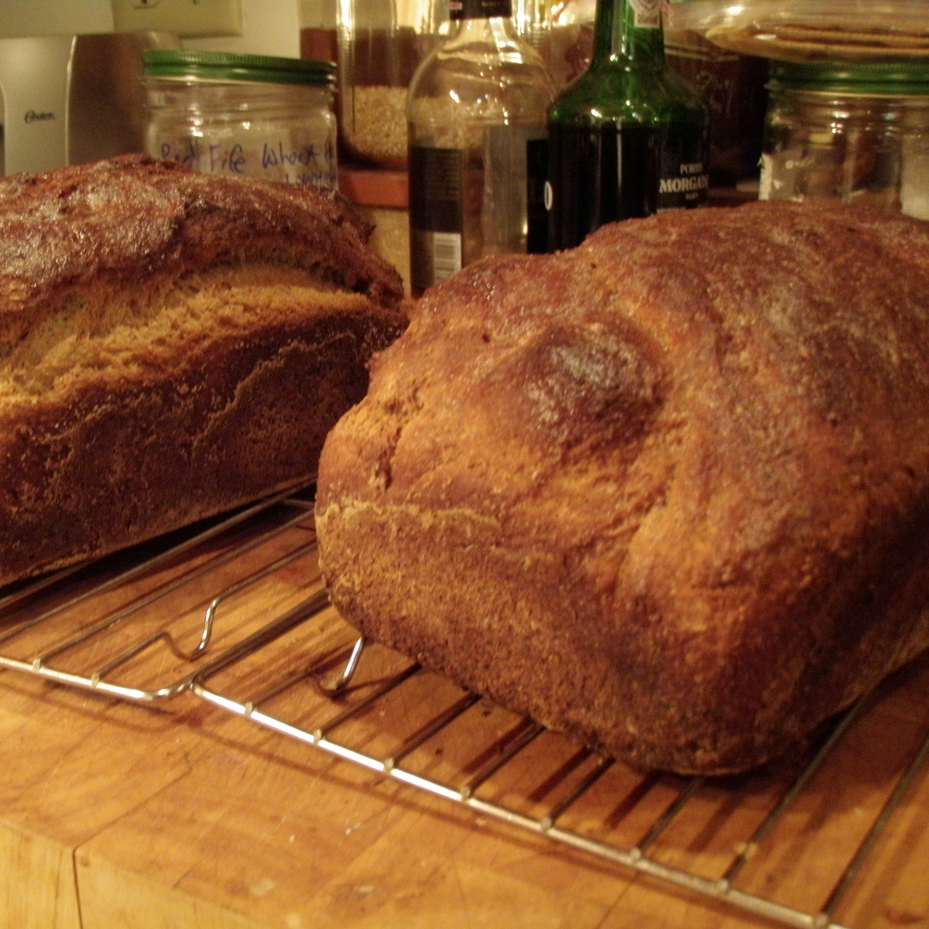
Consider a Corgi/Bread Classifier
Notes:
On Bread
Images scraped from Flickr

Slide 5
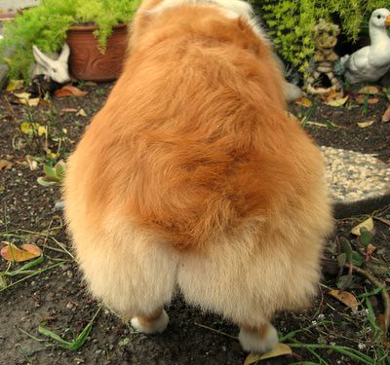
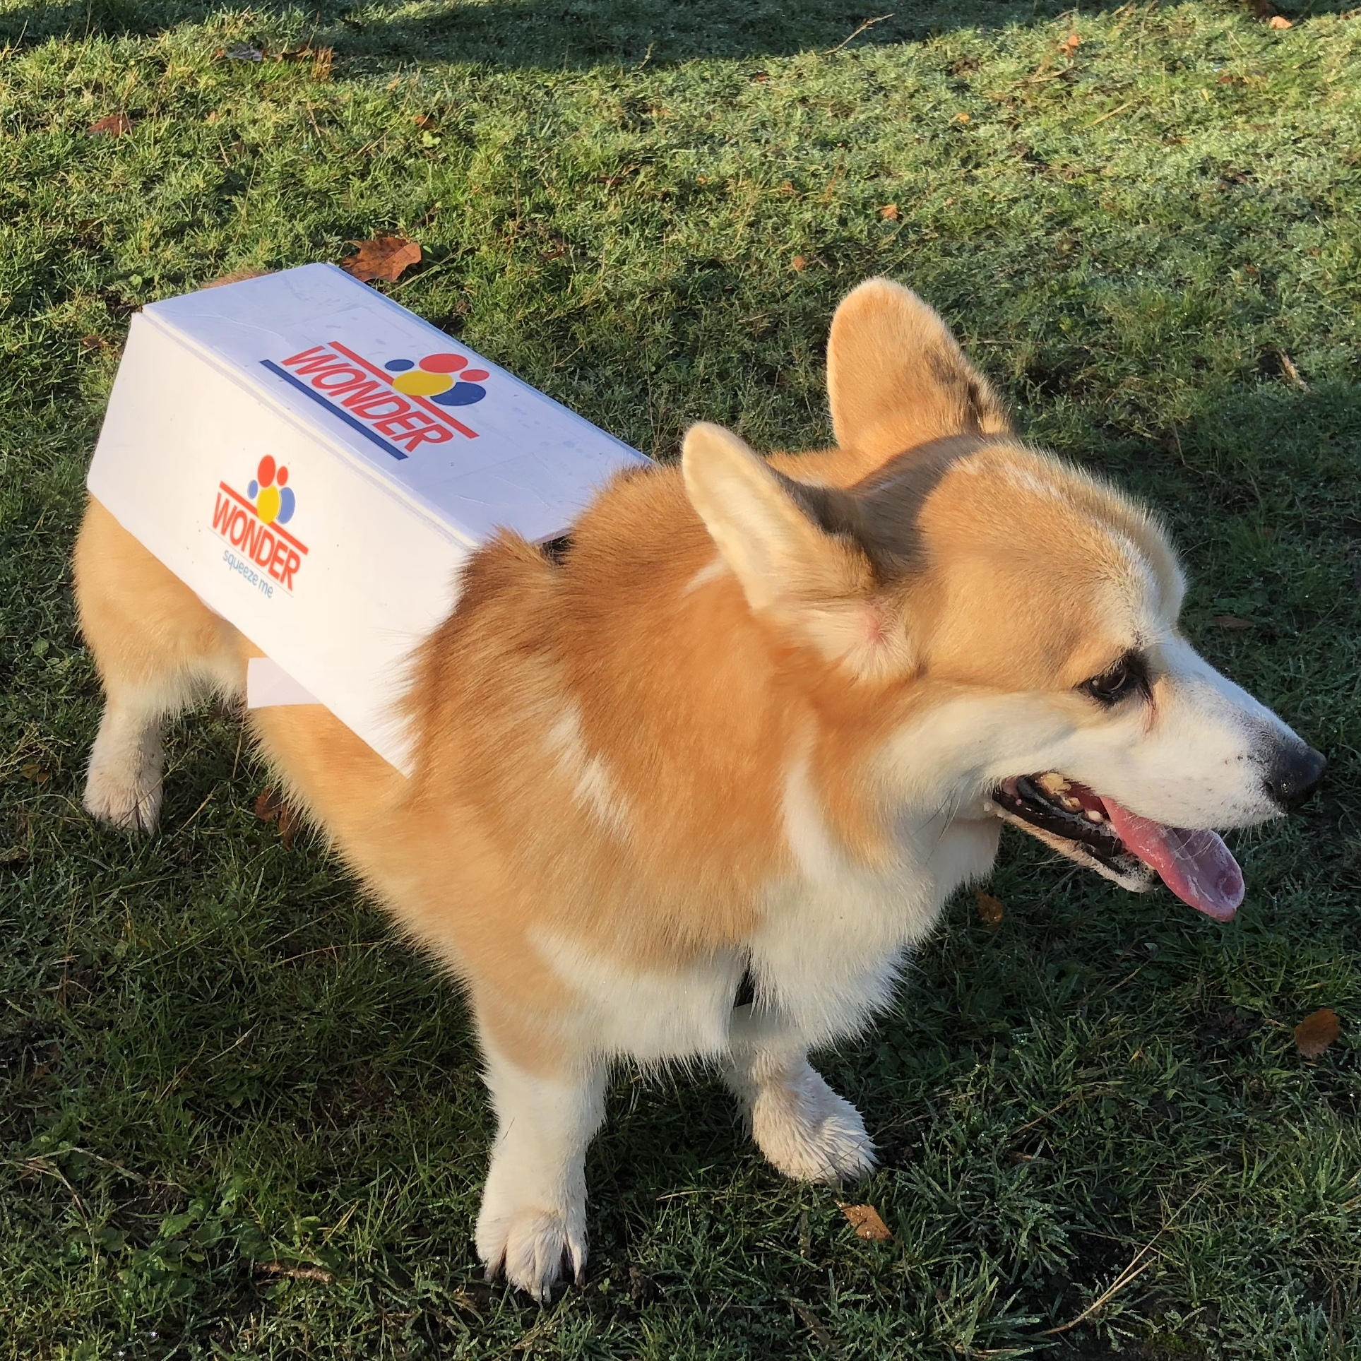
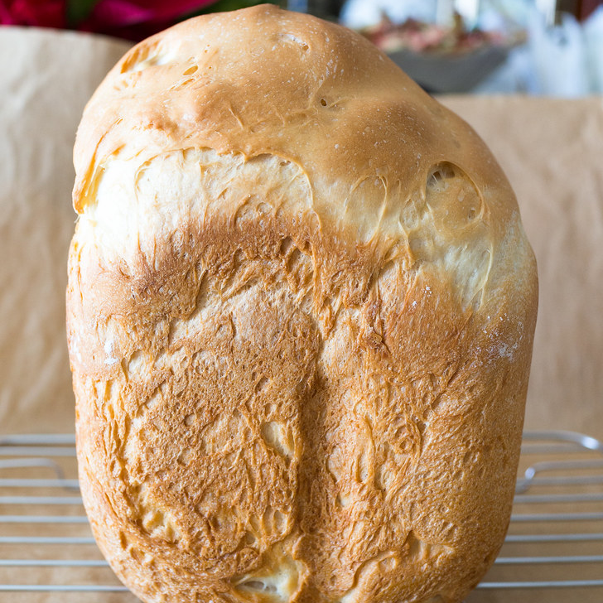
Consider a Corgi/Bread Classifier
Notes:
And on data that’s … somewhere in between.
Images scraped from Flickr

Slide 6
P(Corgi)
P(Bread)
Input Image
Our objective:
Build a holistic understanding of the classifier.
Booth and Zhou et al., Bayes-TrEx, AAAI, 2021
Notes:
Our objective is to build a holistic understanding of this classifier.

Slide 7
Build a holistic understanding of the classifier.
P(Corgi)
P(Bread)
Booth and Zhou et al., Bayes-TrEx, AAAI, 2021
Notes:
What do we mean by “a holistic understanding”?
At the highest level, we mean that a person is able to build an accurate mental model of the classifier.

Slide 8
1. Develop an understanding of class boundaries.
Notes:
One facet of this is being able to build an understanding of the boundaries _between_ classes.
Images: https://www.beano.com/posts/bread-or-corgi-butt

Slide 9
1. Develop an understanding of class boundaries.
True class
Corgi
Bread
Corgi
Bread
51% Corgi, 49% Bread
48% Corgi, 52% Bread
50% Corgi, 50% Bread
45% Corgi, 55% Bread
Classifier’s prediction
Notes:
We want to know when the classifier will be most uncertain about its predicted label of Corgi or Bread.
Images: https://www.beano.com/posts/bread-or-corgi-butt

Slide 10
2. Predict classifier behavior on new examples.
Notes:
A second facet of this task is being able to predict how our classifier will behave when given new, unseen examples.
From left to Right:
Corgi: https://commons.wikimedia.org/wiki/File:ThreeTimeAKCGoldWinnerPembrookeWelshCorgi.jpg
Bread: https://commons.wikimedia.org/wiki/File:Fresh_made_bread_05.jpg
Corgi: https://pixabay.com/photos/corgi-puppy-cute-dog-purebred-pup-4400132/
Bread: https://commons.wikimedia.org/wiki/File:Bread_%D1%85%D0%BB%D0%B5%D0%B1_05.jpg

Slide 11
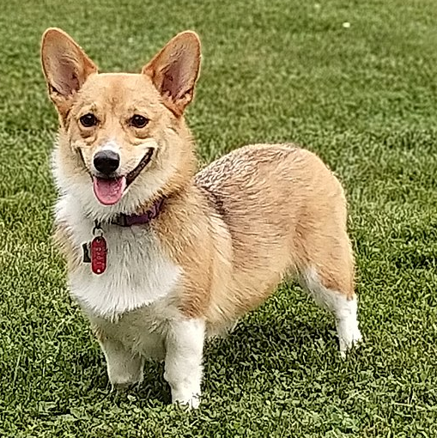
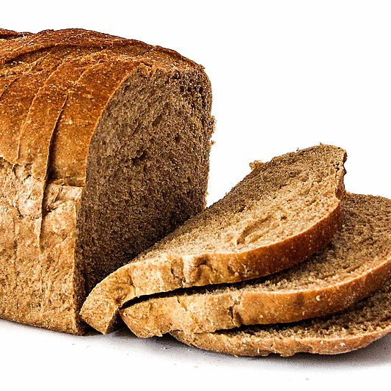
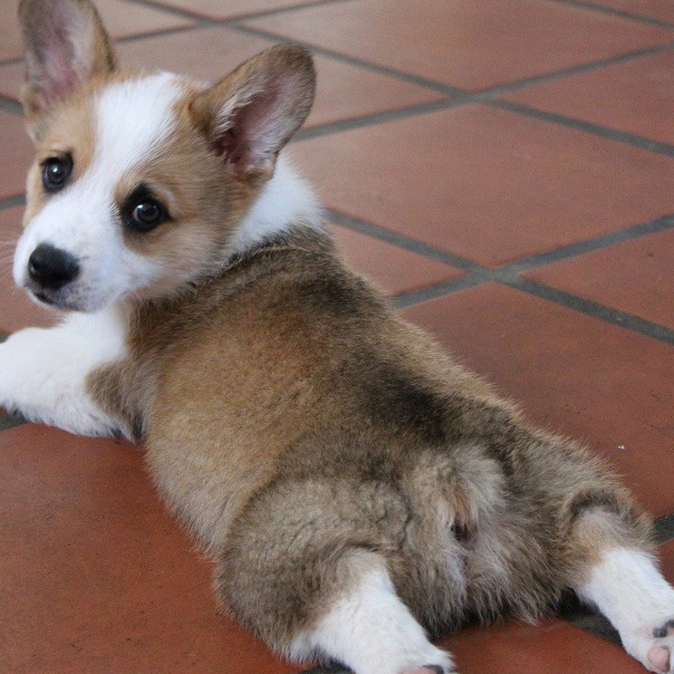
2. Predict classifier behavior on new examples.
True class
Corgi
Bread
Corgi
Bread
Notes:
Are we able to predict …
From left to Right:
Corgi: https://commons.wikimedia.org/wiki/File:ThreeTimeAKCGoldWinnerPembrookeWelshCorgi.jpg
Bread: https://commons.wikimedia.org/wiki/File:Fresh_made_bread_05.jpg
Corgi: https://pixabay.com/photos/corgi-puppy-cute-dog-purebred-pup-4400132/
Bread: https://commons.wikimedia.org/wiki/File:Bread_%D1%85%D0%BB%D0%B5%D0%B1_05.jpg

Slide 12
2. Predict classifier behavior on new examples.
True class
Corgi
Bread
Corgi
Bread
Corgi
Bread
Bread
Corgi
Classifier’s prediction
Notes:
when the classifier might fail?
From left to Right:
Corgi: https://commons.wikimedia.org/wiki/File:ThreeTimeAKCGoldWinnerPembrookeWelshCorgi.jpg
Bread: https://commons.wikimedia.org/wiki/File:Fresh_made_bread_05.jpg
Corgi: https://pixabay.com/photos/corgi-puppy-cute-dog-purebred-pup-4400132/
Bread: https://commons.wikimedia.org/wiki/File:Bread_%D1%85%D0%BB%D0%B5%D0%B1_05.jpg

Slide 13
3. Predict classifier behavior on novel class instances.
Notes:
And lastly, we ML engineers have dreams of training data and in-the-wild data being IID, but in practice, we know that’s unrealistic.
From left to right:
Corgi Cats: https://commons.wikimedia.org/wiki/File:Munchkin_cat_2.jpg
Dog Cake: https://pxhere.com/en/photo/1426927
Panda Croissant: https://sweets.seriouseats.com/2012/10/the-sadness-of-pain-au-chocolat.html
Potatoes: https://commons.wikimedia.org/wiki/File:Potatoes_(4799817714).jpg
Not pictured, but highly relevant:
Alternative Corgi Cats: https://imgur.com/gallery/eDmdV/comment/81102055

Slide 14
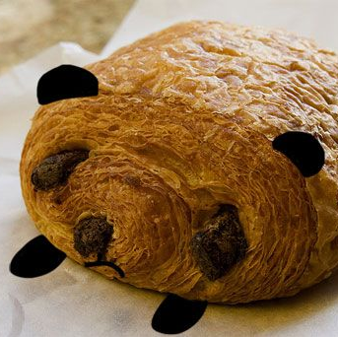
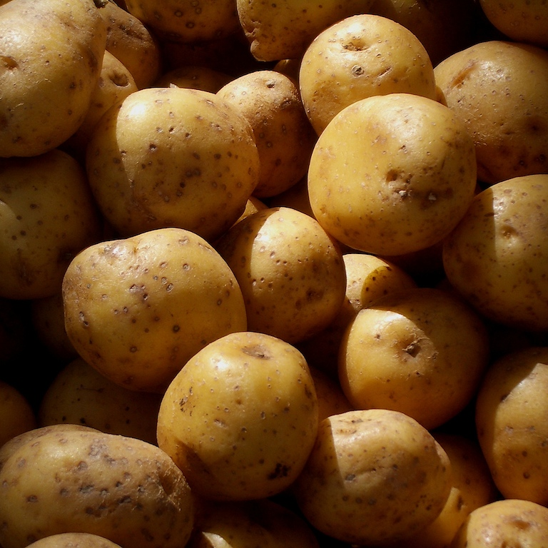
3. Predict classifier behavior on novel class instances.
True class
Cat
Cake
Croissant
Potatoes
Corgi
Corgi
Bread
Bread
Classifier’s prediction
Notes:
To gain a holistic understanding of our classifier, we want to be able to predict how it will behave on examples from novel classes.
From left to right:
Corgi Cats: https://commons.wikimedia.org/wiki/File:Munchkin_cat_2.jpg
Dog Cake: https://pxhere.com/en/photo/1426927
Panda Croissant: https://sweets.seriouseats.com/2012/10/the-sadness-of-pain-au-chocolat.html
Potatoes: https://commons.wikimedia.org/wiki/File:Potatoes_(4799817714).jpg
Not pictured, but highly relevant:
Alternative Corgi Cats: https://imgur.com/gallery/eDmdV/comment/81102055

Slide 15
How can we build this understanding?
Notes:
How can we do this?

Slide 16
Search the test set: ~50% Corgi, ~50% Bread
Test set? Many images.
Notes:
One option is to search the test set.

Slide 17
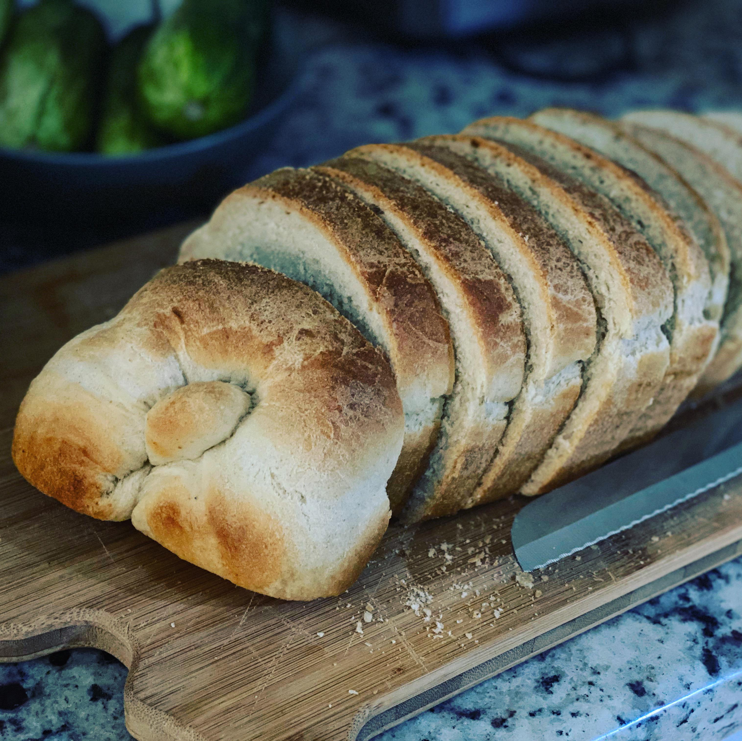
Search the test set: ~50% Corgi, ~50% Bread
Test set? Many images.
Notes:
Imagine we search the many test set images for examples which elicit a prediction of 50% corgi, and 50% bread.

Slide 18
Search the test set: ~50% Corgi, ~50% Bread
Test set? Many images.
50% Confident? Few images.
Notes:
We might find few which lie along the boundary, if any at all.

Slide 19
Search the test set: ~50% Corgi, ~50% Bread
Test set? Many images.
50% Confident? Few images.
Problem: sparse data
Notes:
With such sparse data, building a holistic understanding of the classifier is hard.

Slide 20
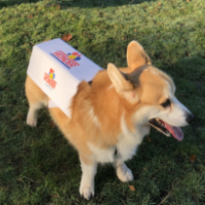
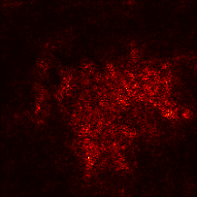
How can we build a holistic understanding?
Explanation
pipeline
Input
Saliency Map
Notes:
An alternative approach is to use an interpretability method, like a saliency map,
which can help us understand why the classifier made a specific classification.

Slide 21
How can we build a holistic understanding?
Explanation
pipeline
Input
Saliency Map
Problem: where does the test input come from?
Notes:
However, most interpretability methods require test inputs.
So that same problem of sparse data is again pertinent!

Slide 22
We introduce Bayes-TrEx: an approach to transparency by example
Booth and Zhou et al., Bayes-TrEx, AAAI, 2021
Notes:
To help with this task of holistic understanding, we introduce Bayes-TrEx.
Let’s walk through how this method works.

Slide 23
We introduce Bayes-TrEx: an approach to transparency by example
Booth and Zhou et al., Bayes-TrEx, AAAI, 2021
Notes:
Consider the decision surface for our Corgi/Bread classifier. It might look something like this.

Slide 24
A Corgi/Bread Decision Surface
P(Corgi) ≅ 1
Booth and Zhou et al., Bayes-TrEx, AAAI, 2021
Notes:
There are points on this surface where the classifier has high Corgi prediction confidence.

Slide 25
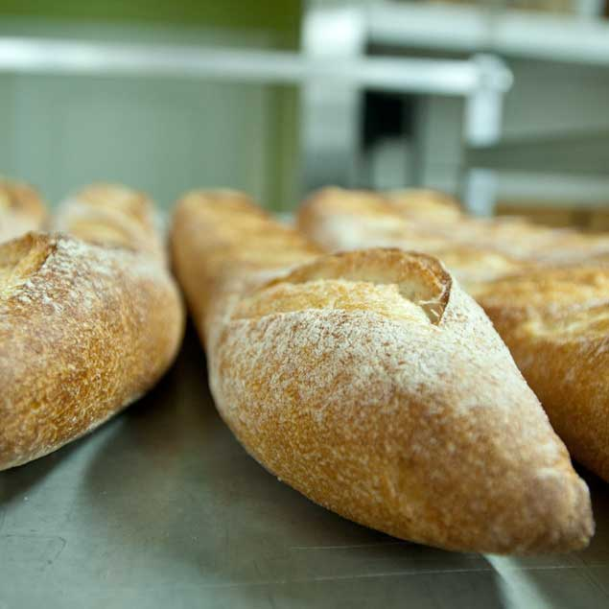
A Corgi/Bread Decision Surface
P(Corgi) ≅ 0
Booth and Zhou et al., Bayes-TrEx, AAAI, 2021
Notes:
And there are other points with high Bread prediction confidence.

Slide 26
A Corgi/Bread Decision Surface
P(Corgi) ≅ 0.5
Booth and Zhou et al., Bayes-TrEx, AAAI, 2021
Notes:
And there are points in between, where the classifier has 50/50 prediction confidence.

Slide 27
A Corgi/Bread Decision Surface
P(Corgi) ≅ 0.5
P(Corgi) = 0.5 Level Set
True Posterior
Booth and Zhou et al., Bayes-TrEx, AAAI, 2021
Notes:
A level set consists of all of the examples where the classifier exhibits some prediction score.
Here, we’re showing the 50% Corgi level set.

Slide 28
We find prediction-matching examples from p-level sets
P(Corgi) ≅ 0.5
P(Corgi) = 0.5 Level Set
True Posterior
Booth and Zhou et al., Bayes-TrEx, AAAI, 2021
Notes:
Our approach to transparency relies on finding examples on these prediction level-sets.

Slide 29
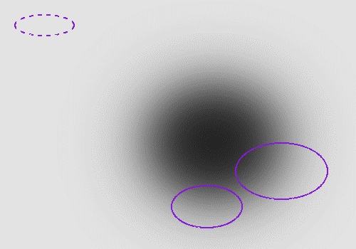
We find prediction-matching examples from p-level sets
P(Corgi) ≅ 0.5
P(Corgi) = 0.5 Level Set
True Posterior
Booth and Zhou et al., Bayes-TrEx, AAAI, 2021
Notes:
Now there’s one thing we have to be careful of here. Consider the density of the data distribution.

Slide 30
We find prediction-matching examples from p-level sets
P(Corgi) ≅ 0.5
P(Corgi) ≅ 0.5
P(Corgi) = 0.5 Level Set
True Posterior
Booth and Zhou et al., Bayes-TrEx, AAAI, 2021
Notes:
We know some classifiers---particularly neural networks---are subject to adversarial examples,
where seemingly random noise can elicit any target prediction confidence.

Slide 31
We find prediction-matching examples from p-level sets
P(Corgi) ≅ 0.5
P(Corgi) ≅ 0.5
P(Corgi) = 0.5 Level Set
True Posterior
Booth and Zhou et al., Bayes-TrEx, AAAI, 2021
Notes:
These seemingly random noise images are not useful for this task of holistic understanding, as they do not help us understand how the classifier behaves on natural images.

Slide 32
We want to find a natural example x where the classifier f (x) has confidence p
P(Corgi) ≅ 0.5
P(Corgi) = 0.5 Level Set
True Posterior
Booth and Zhou et al., Bayes-TrEx, AAAI, 2021
Notes:
We instead want to find only natural image examples, which are plausible under the data distribution.
So: we want to find natural examples where the classifier has a specified prediction confidence value, p.

Slide 33
We want to find a natural example x where the classifier f (x) has confidence p
Want to sample from:
P(Corgi) = 0.5 Level Set
True Posterior
Booth and Zhou et al., Bayes-TrEx, AAAI, 2021
Notes:
Applying Bayes Rule, we consider the problem of sampling from the posterior.
To do so, we consider using Markov Chain Monte Carlo sampling methods – like Hamiltonian Monte Carlo or Metropolis-Hastings.

Slide 34
Want to sample from:
Problem 1:
has small or even zero measure
P(Corgi) = 0.5 Level Set
True Posterior
Booth and Zhou et al., Bayes-TrEx, AAAI, 2021
Notes:
But, there are two problems!
First, when the measure of the level set is small or even zero, sampling directly from this posterior using MCMC methods is infeasible.
Since the posterior is zero everywhere outside of the level set, a random-walk Metropolis sampler is unlikely to land on an example with non-zero posterior.
Since the gradient is zero everywhere outside of the level set, a Hamiltontian Monte Carlo sampler does not have the necessary gradient guidance towards the level set.

Slide 35
Want to sample from:
Problem 1:
has small or even zero measure
Problem 2:
x is too high-dimensional
P(Corgi) = 0.5 Level Set
True Posterior
Booth and Zhou et al., Bayes-TrEx, AAAI, 2021
Notes:
Second, since x is an image, it’s too high dimensional to use MCMC to sample directly.

Slide 36
Want to sample from:
Problem 1:
has small or even zero measure
Problem 2:
x is too high-dimensional
P(Corgi) = 0.5 Level Set
True Posterior
Booth and Zhou et al., Bayes-TrEx, AAAI, 2021
Notes:
So, sampling from this posterior is intractable.

Slide 37
Make inference tractable
Relax the formulation by “widening” the level set
P(Corgi) = 0.5 Level Set
Relaxed Posterior
Booth and Zhou et al., Bayes-TrEx, AAAI, 2021
Notes:
To solve problem 1, we relax the formulation by _widening_ the level set.

Slide 38
Relaxed Formulation
Introduce a random vector:
P(Corgi) = 0.5 Level Set
Relaxed Posterior
Booth and Zhou et al., Bayes-TrEx, AAAI, 2021
Notes:
To do so, we introduce a random variable U, which allows us to accept an example when it’s close to the level set.

Slide 39
Relaxed Formulation
Introduce a random vector:
And sample from the new posterior:
P(Corgi) = 0.5 Level Set
Relaxed Posterior
Booth and Zhou et al., Bayes-TrEx, AAAI, 2021
Notes:
Using this relaxed posterior, we can now use MCMC methods for sampling.

Slide 40
But, how can we sample an image x?
Booth and Zhou et al., Bayes-TrEx, AAAI, 2021
Notes:
You might ask: how can we solve problem 2, and sample an image?

Slide 41
But, how can we sample an image x?
We sample z from a latent space Z, instead.
Booth and Zhou et al., Bayes-TrEx, AAAI, 2021
Notes:
We don’t.
We instead introduce a latent space, with a transformation function (g) such that we can reconstruct the image.
This latent space can be either manually-defined or learned.

Slide 42
But, how can we sample an image x?
We sample z from a latent space Z, instead.
Booth and Zhou et al., Bayes-TrEx, AAAI, 2021
Notes:
We can then sample from this latent space instead.

Slide 43
To use Bayes-TrEx, we need 3 requirements:
Booth and Zhou et al., Bayes-TrEx, AAAI, 2021
Notes:
To use Bayes-TrEx, we have three requirements.

Slide 44
To use Bayes-TrEx, we need 3 requirements:
A classifier which outputs class probabilities
Booth and Zhou et al., Bayes-TrEx, AAAI, 2021
Notes:
First, we need a classifier which outputs class probabilities.

Slide 45
To use Bayes-TrEx, we need 3 requirements:
A classifier which outputs class probabilities
A user-specified confidence target
Booth and Zhou et al., Bayes-TrEx, AAAI, 2021
Notes:
Second, we need a user-specified confidence target.

Slide 46
To use Bayes-TrEx, we need 3 requirements:
A classifier which outputs class probabilities
A user-specified confidence target
A data distribution we can sample from
Booth and Zhou et al., Bayes-TrEx, AAAI, 2021
Notes:
And lastly, we need access to a data distribution, which we can sample from.

Slide 47
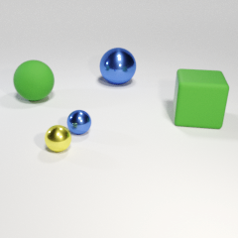
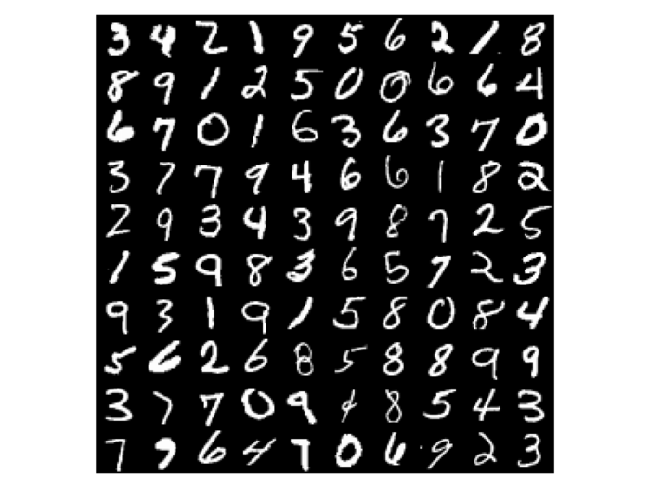
Experiments
CLEVR
MNIST
Fashion-MNIST
Scene graph
VAEs, GANs
VAEs, GANs
Booth and Zhou et al., Bayes-TrEx, AAAI, 2021
Notes:
In our experiments, we consider 3 datasets: CLEVR, MNIST, and Fashion-MNIST.
We use manually defined scene-graph representations to generate CLEVR examples.
And, we use learned VAEs and GANs to generate MNIST and Fashion-MNIST examples.
Note: CLEVR scenes brightened in post-processing for presentation.

Slide 48
Smoke Test: High Confidence Examples (p_{i}=1, p_{¬i}=0)
Booth and Zhou et al., Bayes-TrEx, AAAI, 2021
Notes:
To use Bayes-TrEx, we manipulate the relationship between the classifier’s training distribution, and the data distribution from which we sample.
Let P_C be the classifier training distribution, here presented in red.

Slide 49
Smoke Test: High Confidence Examples (p_{i}=1, p_{¬i}=0)
Booth and Zhou et al., Bayes-TrEx, AAAI, 2021
Notes:
Let P_D be the data distribution we use with Bayes-TrEx, here shown in Yellow.

Slide 50
Smoke Test: High Confidence Examples (p_{i}=1, p_{¬i}=0)
Booth and Zhou et al., Bayes-TrEx, AAAI, 2021
Notes:
The first relationship we consider sets these two distributions to be equal.

Slide 51
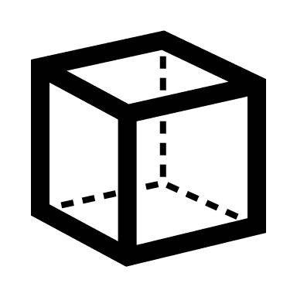
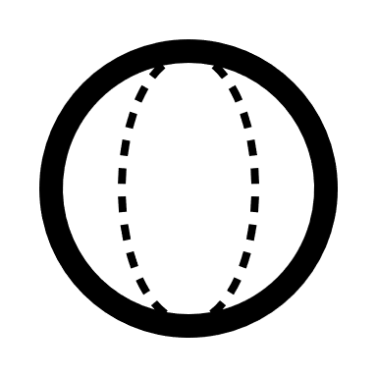
Smoke Test: High Confidence Examples (p_{i}=1, p_{¬i}=0)
Booth and Zhou et al., Bayes-TrEx, AAAI, 2021
Notes:
In the case of CLEVR, that means the classifier is trained on scenes consisting of cubes, spheres, and cylinders,
And similarly, the Bayes-TrEx data distribution includes just these three shapes as well.

Slide 52
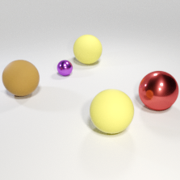
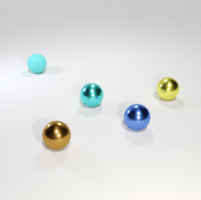
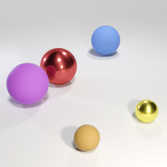
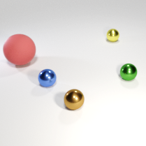
Smoke Test: High Confidence Examples (p_{i}=1, p_{¬i}=0)
CLEVR:
5 Spheres
Booth and Zhou et al., Bayes-TrEx, AAAI, 2021
Notes:
The first test we run is a smoke test – a simple experiment to confirm Bayes-TrEx is working as intended.
We want to find examples where the classifier is highly confident.
Here We show some examples where the classifier is certain that the scene contains 5 spheres
Note: CLEVR scenes brightened in post-processing for presentation.

Slide 53
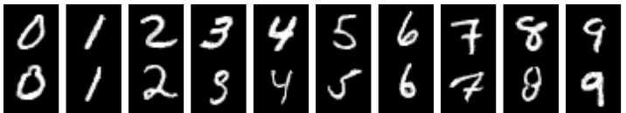
Smoke Test: High Confidence Examples (p_{i}=1, p_{¬i}=0)
CLEVR:
5 Spheres
MNIST
Booth and Zhou et al., Bayes-TrEx, AAAI, 2021
Notes:
Here are examples for each MNIST digit, 0 through 9
Note: CLEVR scenes brightened in post-processing for presentation.

Slide 54
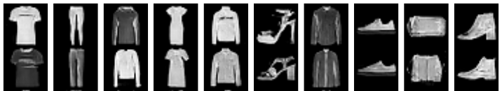
Smoke Test: High Confidence Examples (p_{i}=1, p_{¬i}=0)
CLEVR:
5 Spheres
MNIST
Fashion-
MNIST
Booth and Zhou et al., Bayes-TrEx, AAAI, 2021
Notes:
, and finally, examples for each Fashion-MNIST class, tshirts through ankle boots.
Note: CLEVR scenes brightened in post-processing for presentation.

Slide 55
Smoke Test: High Confidence Examples (p_{i}=1, p_{¬i}=0)
CLEVR:
5 Spheres
≈0.943
MNIST
≈0.999
Fashion-
MNIST
≈0.998
Booth and Zhou et al., Bayes-TrEx, AAAI, 2021
Notes:
We confirm that the associated confidences are indeed close to the specified target.
Great, we passed our smoke test!
Note: CLEVR scenes brightened in post-processing for presentation.

Slide 56
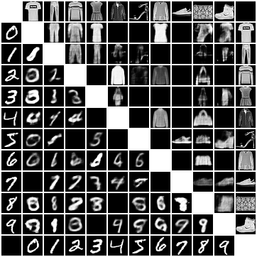
Class Boundaries (p_{i}=0.5, p_{j}=0.5, p_{¬i,¬j} =0)
1
2
3
4
5
6
7
8
9
0
1
2
3
4
5
6
7
8
Booth and Zhou et al., Bayes-TrEx, AAAI, 2021
Notes:
The next test we run is to find ambiguous examples, or examples which reveal class boundaries.
We set the prediction target to be ambiguous between two classes.
Here we show a matrix showing ambiguous examples for all pairs of MNIST classes.

Slide 57
Class Boundaries (p_{i}=0.5, p_{j}=0.5, p_{¬i,¬j} =0)
1
2
3
4
5
6
7
8
8 v 9
9
0
1
2
3
4
5
6
7
8
Booth and Zhou et al., Bayes-TrEx, AAAI, 2021
Notes:
To help build our understanding of class boundaries, we can look at additional ambiguous examples for a specific class pairing.
Here we’re showing a handful more for the 8 vs 9 class.

Slide 58
Class Boundaries (p_{i}=0.5, p_{j}=0.5, p_{¬i,¬j} =0)
1
2
3
4
5
6
7
8
9
0
1
2
3
4
5
6
7
8
Booth and Zhou et al., Bayes-TrEx, AAAI, 2021
Notes:
Bayes-TrEx is generally successful at finding examples which are ambiguous to the classifier, but we’re not able to find examples for 7 MNIST class pairings.

Slide 59
Class Boundaries (p_{i}=0.5, p_{j}=0.5, p_{¬i,¬j} =0)
1
2
3
4
5
6
7
8
9
0
1
2
3
4
5
6
7
8
Booth and Zhou et al., Bayes-TrEx, AAAI, 2021
Notes:
we did not find an ambiguous example which is half 4 and half 8.
This is not unexpected.
While the examples we find are ambiguous from the classifier’s perspective, we still see sampling failures on semantically dissimilar classes.

Slide 60
Class Boundaries (p_{i}=0.5, p_{j}=0.5, p_{¬i,¬j} =0)
0
1
2
3
4
5
6
7
8
1
1
2
2
3
3
4
4
5
5
6
6
7
7
8
8
9
9
0
1
2
3
4
5
6
7
8
Booth and Zhou et al., Bayes-TrEx, AAAI, 2021
Notes:
We conduct the same class boundary analysis for Fashion-MNIST, as well.
Overall, we found ambiguous examples for 66 class pairings.

Slide 61
High Confidence Failures
Booth and Zhou et al., Bayes-TrEx, AAAI, 2021
Notes:
We next consider high confidence failures.
This class of failures is especially interesting.
While classification failures are unwanted in general, high confidence failures may be less likely to be caught.

Slide 62
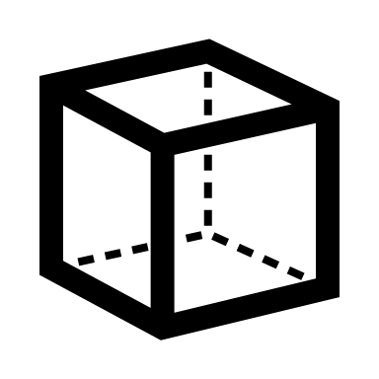
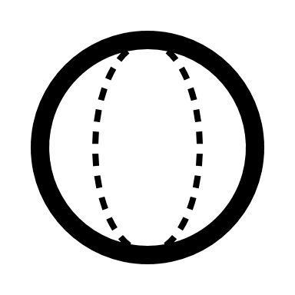
High Confidence Failures
Booth and Zhou et al., Bayes-TrEx, AAAI, 2021
Notes:
To find these high confidence failures, we restrict the data distribution to exclude one or more classes.
Here, the classifier is still trained on cubes, spheres, AND cylinders,

Slide 63
High Confidence Failures
Booth and Zhou et al., Bayes-TrEx, AAAI, 2021
Notes:
but the data distribution is only trained on spheres and cylinders.

Slide 64
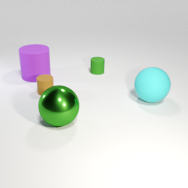
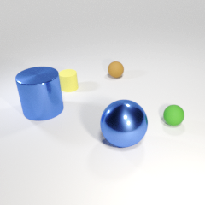
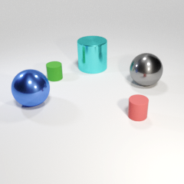
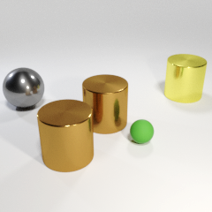
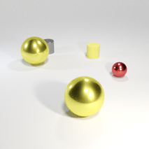
High Confidence Failures
97.2%
96.0%
94.5%
67.3%
93.5%
Contains 1 Cube
Booth and Zhou et al., Bayes-TrEx, AAAI, 2021
Notes:
We use Bayes-TrEx to find high-confidence failures in CLEVR.
In all of these scenes, the classifier claims there is exactly one cube.
However, there are no cubes in any of these scenes: they are composed only of spheres and cylinders.

Slide 65
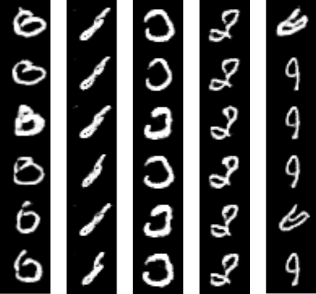
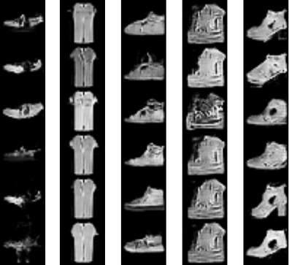
High Confidence Failures
0: 0.981 ± 0.027
1: 0.953 ± 0.028
2: 0.968 ± 0.028
3: 0.969 ± 0.027
4: 0.955 ± 0.030
Sandal: 0.986 ± 0.030
Shirt: 0.938 ± 0.032
Sneaker: 0.969 ± 0.028
Bag: 0.967 ± 0.026
Ankle boot: 0.971 ± 0.027
Booth and Zhou et al., Bayes-TrEx, AAAI, 2021
Notes:
We then use Bayes-TrEx to find high-confidence failures in MNIST and Fashion-MNIST.
We train GANs by excluding the class of interest.
For MNIST, some thin 8s are classified as 1s, and particular styles of 6s and 9s are classified as 4s. These results seem intuitive, as a human might make similar mistakes.
Like-wise, for Fashion-MNIST, most failures come from semantically similar classes, for example confusing sneakers and ankle boots.

Slide 66
High Confidence Failures
0: 0.981 ± 0.027
1: 0.953 ± 0.028
2: 0.968 ± 0.028
3: 0.969 ± 0.027
4: 0.955 ± 0.030
Sandal: 0.986 ± 0.030
Shirt: 0.938 ± 0.032
Sneaker: 0.969 ± 0.028
Bag: 0.967 ± 0.026
Ankle boot: 0.971 ± 0.027
Booth and Zhou et al., Bayes-TrEx, AAAI, 2021
Notes:
Less intuitively, however, chunky shoes are likely to be classified as bags.
By evaluating these examples, we can assess how well human-aligned a classifier is.

Slide 67
Novel Class Extrapolation
Booth and Zhou et al., Bayes-TrEx, AAAI, 2021
Notes:
We now consider how the classifier responds to instances from novel classes.
The classifier training distribution is again fixed. For CLEVR, it’s trained with cubes, spheres, and cylinders.
3D Corgi Model: https://free3d.com/3d-model/cardigan-welsh-corgi-v1--784056.html​

Slide 68
Novel Class Extrapolation
Booth and Zhou et al., Bayes-TrEx, AAAI, 2021
Notes:
On the other hand, the BayesTrEx data distribution excludes cubes, but introduces a new class of Corgis.
3D Corgi Model: https://free3d.com/3d-model/cardigan-welsh-corgi-v1--784056.html​

Slide 69
Novel Class Extrapolation
Contains 5 Cubes: 89.3%
Booth and Zhou et al., Bayes-TrEx, AAAI, 2021
Notes:
We then use Bayes-TrEx to generate scenes where the classifier is highly confident 5 cubes are present.
Here is one such scene – which contains 3 corgis, one sphere, one cylinder, and ZERO cubes.
Note: CLEVR scenes brightened in post-processing for presentation.
3D Corgi Model: https://free3d.com/3d-model/cardigan-welsh-corgi-v1--784056.html​

Slide 70
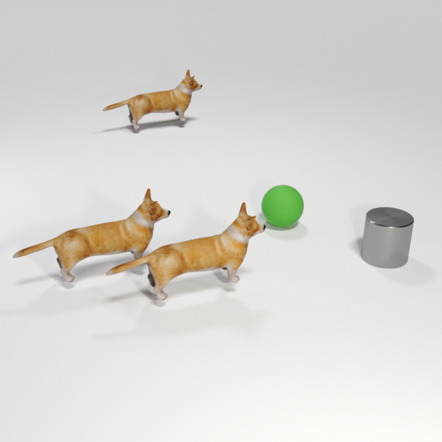
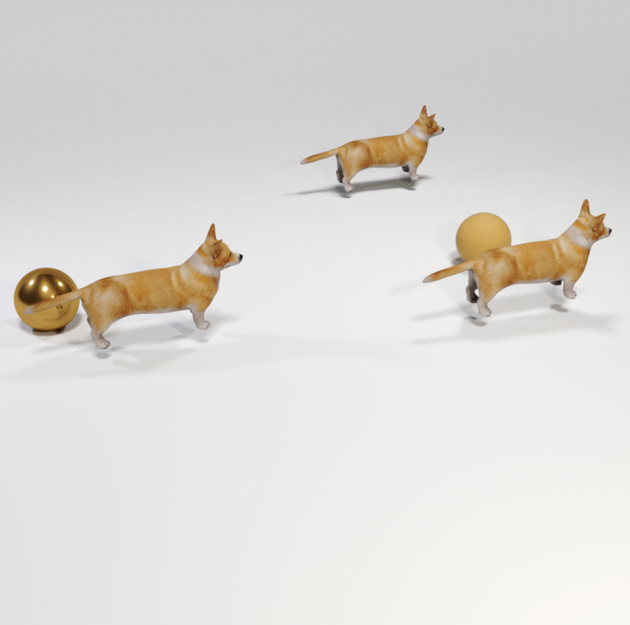
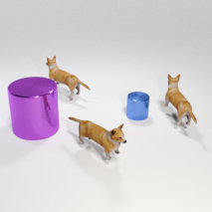
Novel Class Extrapolation
89.3%
81.2%
83.5%
90.4%
90.5%
Contains 5 Cubes
Booth and Zhou et al., Bayes-TrEx, AAAI, 2021
Notes:
To demonstrate this is not a fluke, here are several more examples uncovered with Bayes-TrEx.
Note: CLEVR scenes brightened in post-processing for presentation.
3D Corgi Model: https://free3d.com/3d-model/cardigan-welsh-corgi-v1--784056.html​

Slide 71
Domain Adaptation
Booth and Zhou et al., Bayes-TrEx, AAAI, 2021
Notes:
The final experiment we’ll present here concerns domain adaptation.
For this experiment, we train classifiers using the SVHN street view dataset.

Slide 72
Domain Adaptation
Booth and Zhou et al., Bayes-TrEx, AAAI, 2021
Notes:
And we use a test distribution consisting of MNIST digits.

Slide 73
Domain Adaptation: ADDA
Overall:
Baseline: 61% accuracy
ADDA: 71% accuracy
Booth and Zhou et al., Bayes-TrEx, AAAI, 2021
Notes:
First, we compare the performance of a baseline classifier and ADDA, a popular domain adaptation model.
These first results suggest the expected: that the model which is known for domain adaptation is better at this task (scoring 71% accuracy overall, compared to 61% for the baseline).

Slide 74
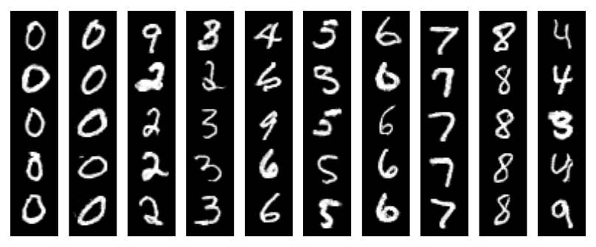
Domain Adaptation: ADDA
Overall:
Baseline: 61% accuracy
ADDA: 71% accuracy
Booth and Zhou et al., Bayes-TrEx, AAAI, 2021
Notes:
While the ADDA model achieves higher overall accuracy, this isn’t the whole story.
We use Bayes-TrEx to find high-confidence examples.

Slide 75
Domain Adaptation: ADDA
Overall:
Baseline: 61% accuracy
ADDA: 71% accuracy
High Confidence Examples:
Baseline: 80% accuracy
ADDA: 72% accuracy
Booth and Zhou et al., Bayes-TrEx, AAAI, 2021
Notes:
When we then relabel a random sample of these, we find that the ADDA model has lower accuracy than the baseline on these high confidence examples.
This suggests that the ADDA model has worse confidence calibration.

Slide 76
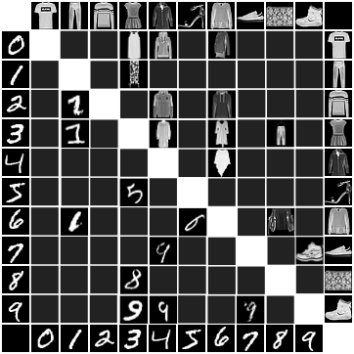
How does Bayes-TrEx compare to the test set?
Test set:
22 Ambiguous Pairings
Booth and Zhou et al., Bayes-TrEx, AAAI, 2021
Notes:
So how does Bayes-TrEx compare to the test set?
For the task of finding ambiguous examples, the test set has just 22 class pairings.

Slide 77
How does Bayes-TrEx compare to the test set?
Booth and Zhou et al., Bayes-TrEx, AAAI, 2021
Notes:
In comparison, Bayes-TrEx found examples for 66 class pairings

Slide 78
How does Bayes-TrEx compare to the test set?
Test set exposes more mislabelings than true classification failures.
Booth and Zhou et al., Bayes-TrEx, AAAI, 2021
Notes:
When looking at high-confidence misclassifications, we find that the majority of uncovered test set examples are not classification failures.
Instead, they are mislabeled examples.

Slide 79
How does Bayes-TrEx compare to the test set?
Class: 2
Test set exposes more mislabelings than true classification failures.
Mislabeled
Misclassified
Booth and Zhou et al., Bayes-TrEx, AAAI, 2021
Notes:
If we look, for example, at the high confidence misclassifications for MNIST digit 2, we see these three examples:

Slide 80
How does Bayes-TrEx compare to the test set?
Class: 2
Test set exposes more mislabelings than true classification failures.
Mislabeled
Misclassified
Booth and Zhou et al., Bayes-TrEx, AAAI, 2021
Notes:
A 7

Slide 81
How does Bayes-TrEx compare to the test set?
Class: 2
Test set exposes more mislabelings than true classification failures.
Mislabeled
Misclassified
Booth and Zhou et al., Bayes-TrEx, AAAI, 2021
Notes:
A 3

Slide 82
How does Bayes-TrEx compare to the test set?
Class: 2
Test set exposes more mislabelings than true classification failures.
Mislabeled
Misclassified
Booth and Zhou et al., Bayes-TrEx, AAAI, 2021
Notes:
And a 1

Slide 83
How does Bayes-TrEx compare to the test set?
Class: 2
Test set exposes more mislabelings than true classification failures.
Mislabeled
Misclassified
Booth and Zhou et al., Bayes-TrEx, AAAI, 2021
Notes:
For this class we find *no* incorrectly classified examples.

Slide 84
How does Bayes-TrEx compare to the test set?
Class: 2
Test set exposes more mislabelings than true classification failures.
60/84 MNIST
42/93 Fashion-MNIST
Mislabeled
Misclassified
Booth and Zhou et al., Bayes-TrEx, AAAI, 2021
Notes:
Overall we found:
60/84 MNIST examples
and 42/93 Fashion-MNIST examples to be mislabeled.
While finding mislabeled examples may be a useful task, it is not helpful for building our holistic understanding of classifier behavior.

Slide 85
Bayes-TrEx
Class Boundaries
Booth and Zhou et al., Bayes-TrEx, AAAI, 2021
Notes:
In summary, we’ve shown how Bayes-TrEx can help us understand class boundaries, by finding ambiguous examples.
Note: CLEVR scenes brightened in post-processing for presentation.
3D Corgi Model: https://free3d.com/3d-model/cardigan-welsh-corgi-v1--784056.html​

Slide 86
Bayes-TrEx
Class Boundaries
High Confidence Failures
Booth and Zhou et al., Bayes-TrEx, AAAI, 2021
Notes:
We’ve shown how Bayes-TrEx can help us understand when a model will make failures with high-confidence.
Note: CLEVR scenes brightened in post-processing for presentation.
3D Corgi Model: https://free3d.com/3d-model/cardigan-welsh-corgi-v1--784056.html​

Slide 87
Bayes-TrEx
Class Boundaries
High Confidence Failures
Novel Classes
Booth and Zhou et al., Bayes-TrEx, AAAI, 2021
Notes:
And we’ve shown how Bayes-TrEx can be used to assess how a model will respond to novel classes.
Note: CLEVR scenes brightened in post-processing for presentation.
3D Corgi Model: https://free3d.com/3d-model/cardigan-welsh-corgi-v1--784056.html​

Slide 88
Limitation 1: Trends & Coverage Measures
Booth and Zhou et al., Bayes-TrEx, AAAI, 2021
Notes:
Of course, Bayes-TrEx has some limitations.
First, Bayes-TrEx is a method for finding examples for increased transparency into a classifier.
However, it’s still hard to work with these individual examples.
To make this technique more useful, we need methods for extracting trends and understanding the sampled coverage of the level set.

Slide 89
Limitation 2: Latent Space Dimensionality
Object 1: {
shape: {cube, sphere, cylinder}
color: {cyan, …, green},
material: {rubber, metal},
x-coord: [0,1],
y-coord: [0,1],
r-coord: [0, 2pi)
},
…,
Object 5: {
shape: {cube, sphere, cylinder}
color: {cyan, …, green},
material: {rubber, metal},
x-coord: [0,1],
y-coord: [0,1],
r-coord: [0, 2pi)
}
z
Encoder
Decoder
Latent: 10-dim
Booth and Zhou et al., Bayes-TrEx, AAAI, 2021
Notes:
Second, Bayes-TrEx uses MCMC methods for sampling.
While Bayes-TrEx is in principle agnostic to the form of the data distribution, the dimensionality of the latents cannot be too large, as
MCMC sampling in high dimensional spaces remains an open problem.

Slide 90
Limitation 3: Transparency for Classification Tasks
P(Corgi)
P(Bread)
Input Image
Booth and Zhou et al., Bayes-TrEx, AAAI, 2021
Notes:
The last limitation we’ll note is that the Bayes-TrEx formulation only provides transparency for classification tasks.
But, there are many other black box models which could benefit from this type of transparency technique:
for example, machine translation or robot motion controller tasks.

Slide 91
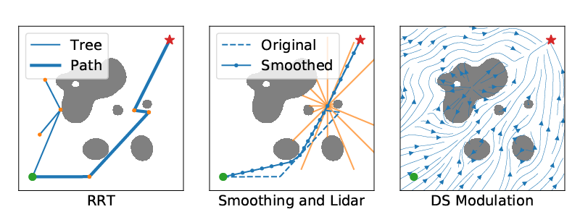
Limitation 3: Transparency for Classification Tasks
In Review & On ArXiv (2012.13615):
Zhou et al., RoCUS: Robot Controller Understanding via Sampling
Booth and Zhou et al., Bayes-TrEx, AAAI, 2021
Notes:
But in the 6 months since the AAAI deadline, we’ve been keeping busy!
In our new submission, we adapt the Bayes-TrEx formulation to provide transparency into robot controllers.
While this work is currently in review, we uploaded a pre-print to Arxiv in case you want to check it out.

Slide 92
Bayes-TrEx
Paper, code, & many more experiments: github.com/serenabooth/bayes-trex
Serena Booth*
@SerenaLBooth
Yilun Zhou*
yilun@mit.edu
Ankit Shah
@ankitjs
Julie Shah
@julie_a_shah
Follow up (robotics): arxiv.org/abs/2012.13615
Notes:
We include many more experiments in our full paper and supplemental material.
We also posted our code online, so feel free to try Bayes-TrEx yourself.
Thank you!

