Slide 1
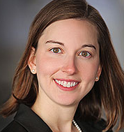
IJCAI 2019
Communicating Logical Statements Effectively
Evaluating the Interpretability of the
Knowledge Compilation Map
Serena Booth
Christian Muise
Julie Shah
Contact author: serenabooth@csail.mit.edu
Notes:
Hi everyone! I’m Serena Booth, I’m a PhD student at MIT, and today I’m going to be talking about communicating logical statements effectively.
We’ve seen tremendous gains recently in machine learning. But these models are usually black boxes.
And we, as a society, are currently deciding that we do not want uninterpretable systems determining our lives. <ADVANCE>

Slide 2
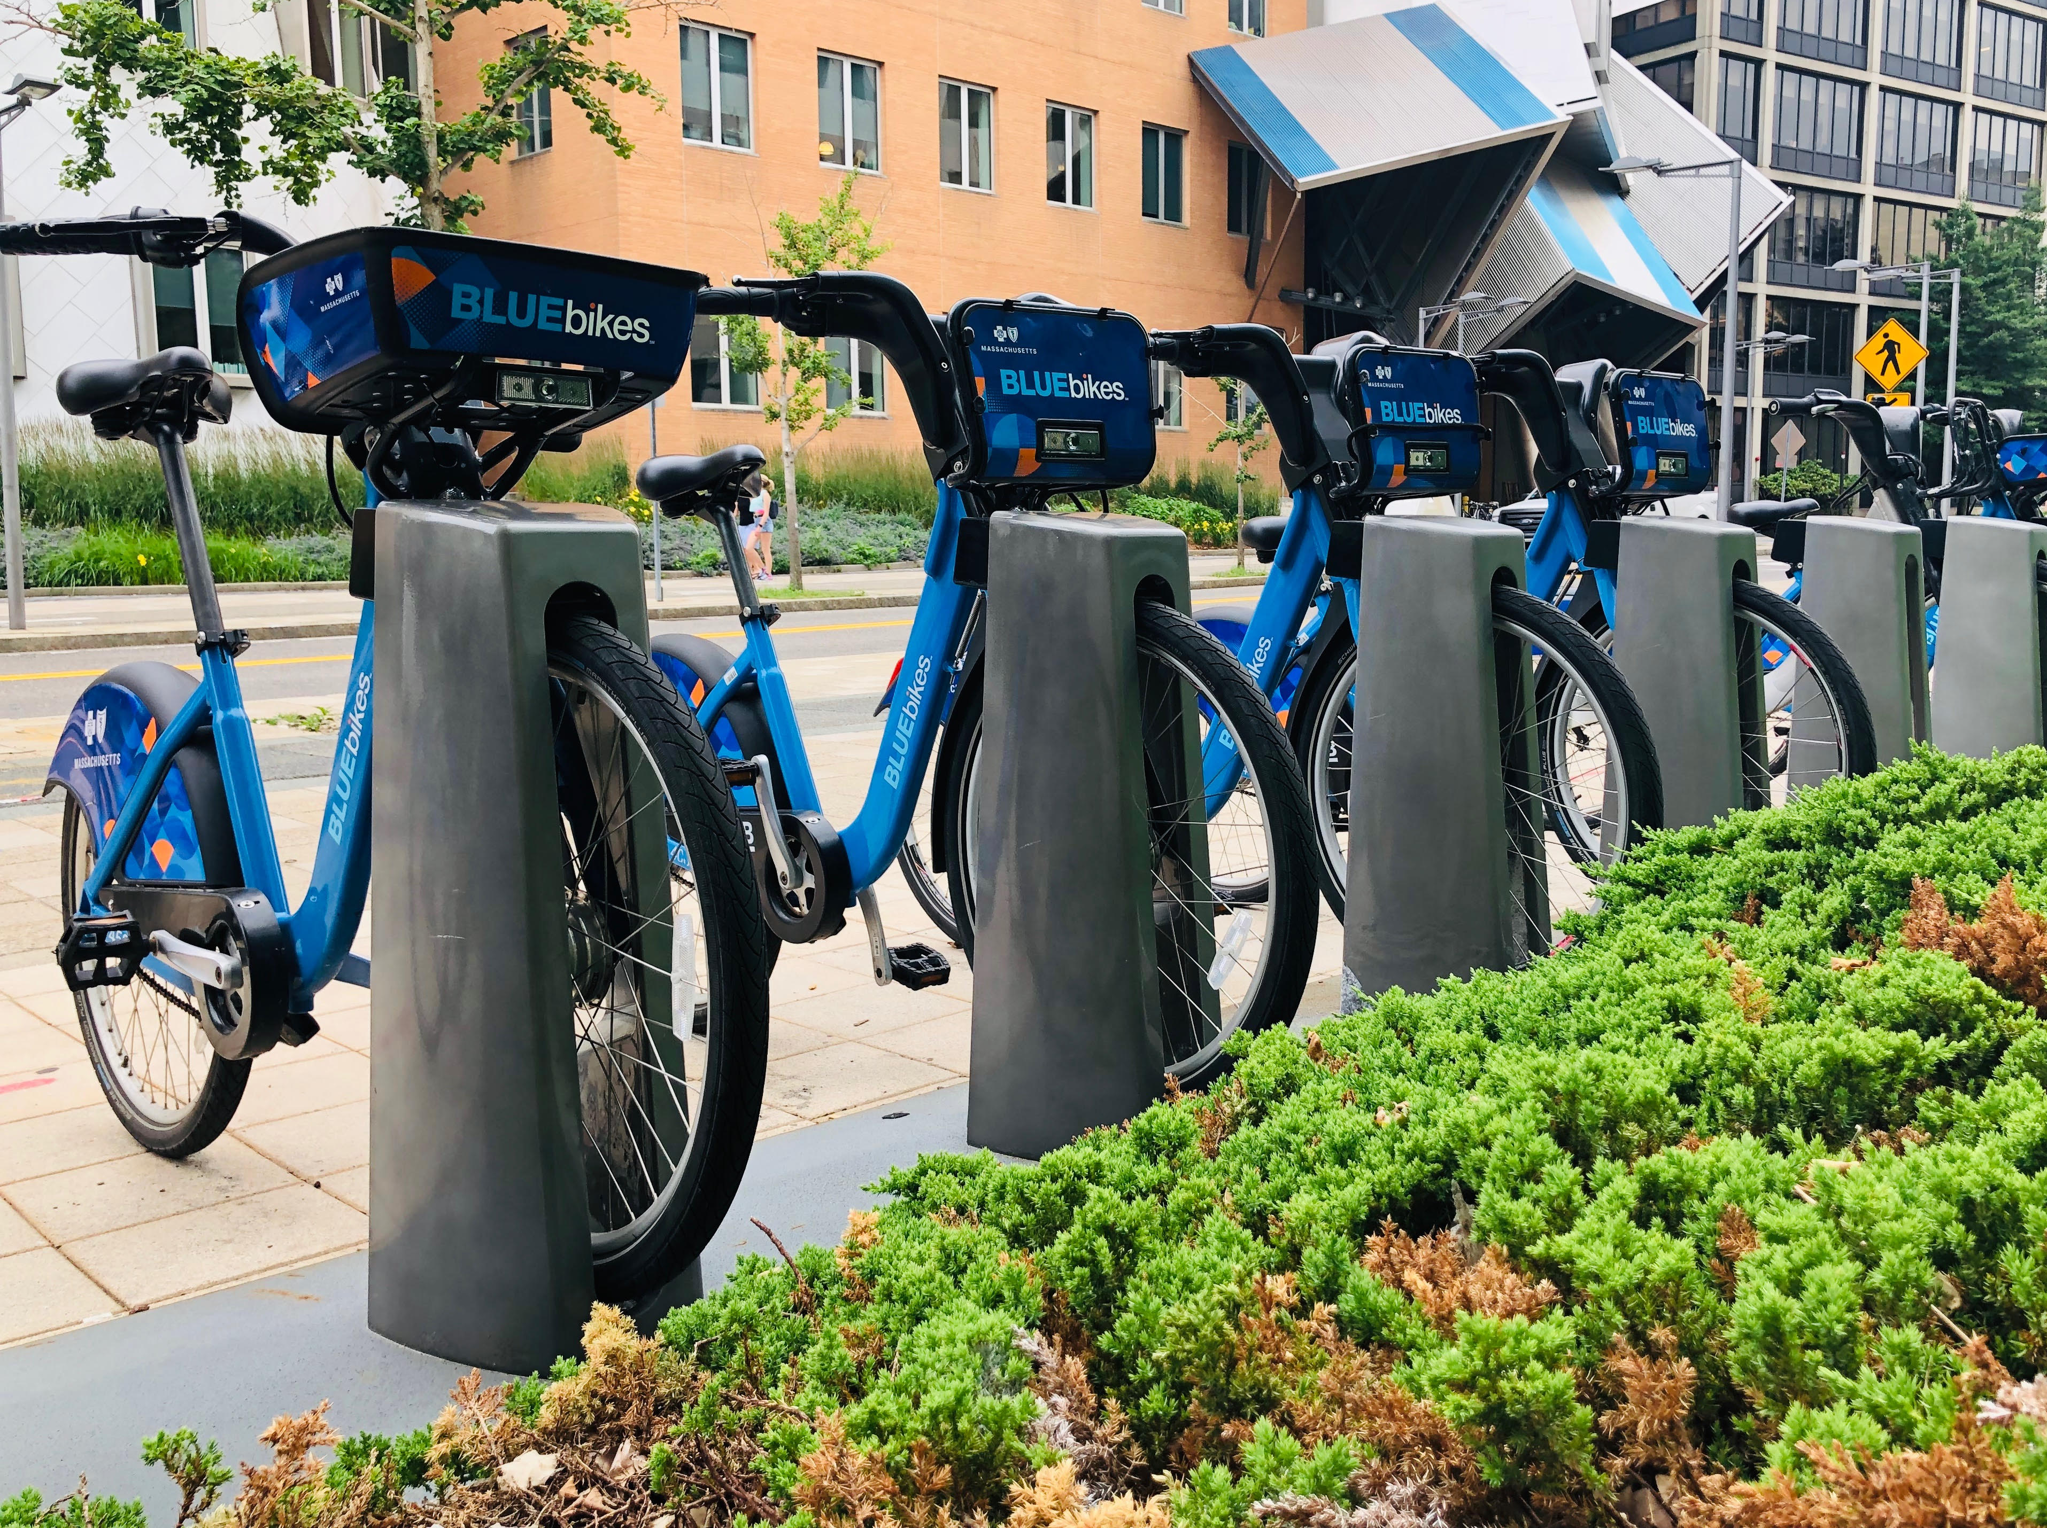
Notes:
It could be whether our neighborhood has bikes available in the morning, <ADVANCE>
Bikes picture: taken by Serena

Slide 3
Notes:
whether we are able to get a mortgage on our home, <ADVANCE>
Bikes picture: taken by Serena
Mortgage application picture: http://www.picserver.org/m/mortgage01.html

Slide 4
Notes:
whether we’re granted bail, <ADVANCE>
Bikes picture: taken by Serena
Mortgage application picture: http://www.picserver.org/m/mortgage01.html
Lady Justice: https://pixabay.com/photos/justice-statue-lady-justice-2060093/

Slide 5
Notes:
or what medical care we receive. <ADVANCE>
Bikes picture: taken by Serena
Mortgage application picture: http://www.picserver.org/m/mortgage01.html
Lady Justice: https://pixabay.com/photos/justice-statue-lady-justice-2060093/
Medical Care: https://pxhere.com/en/photo/1457247

Slide 6
A Legal Right to an Explanation
Notes:
This future of uninterpretable systems making important decisions is something we’re starting to guard against.
In 2017, the European Union ruled in GDPR that all system users have a “right to an explanation.”
Bikes picture: taken by Serena
Mortgage application picture: http://www.picserver.org/m/mortgage01.html
Lady Justice: https://pixabay.com/photos/justice-statue-lady-justice-2060093/
Medical Care: https://pxhere.com/en/photo/1457247

Slide 7
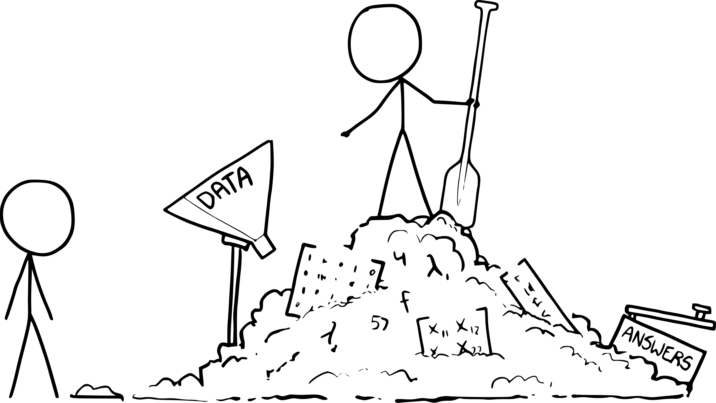
What is interpretability?
[XKCD]
Notes:
But what does it mean to give an explanation?
It is insufficient to say, “We fed data to linear algebra, and here are the matrices which explain why you were refused your organ transplant.”
https://xkcd.com/1838/ + https://www.vectorization.org/

Slide 8
What is interpretability?
Expressed in propositional logic or similar.
[Hayes and Shah, 2017; Angelino et al., 2018; Garofalakis et al., 2000]
Notes:
So we ask what it means for an explanation to be interpretable. Well, one operational definition of interpretability is “expressed in propositional logic.”
https://people.csail.mit.edu/beenkim/papers/BeenK_FinaleDV_ICML2017_tutorial.pdf

Slide 9
True
False
Notes:
Let’s test this with a game. I’m going to show you a propositional theory along with an input. If it’s true for this input, give me a thumbs up! If it’s false, give me a thumbs down.
GIVE A BIG THUMBS UP/ DOWN

Slide 10
Input: [IJCAI, 2019, Macao, August]
All of: • Conference = IJCAI
• One or both of: • Year = 2019
• Location = Macao
• Month = August
True
False
Notes:
OK, here’s your first propositional theory!

Slide 11
Input: [IJCAI, 2019, Macao, August]
Not all of: • Conference = ICML
• None of: • Year = 2019
• Location = Macao
• Month = July
True
False
Notes:
Not too bad, right? Let’s try a harder one?
Show me your thumbs

Slide 12
Input: [IJCAI, 2019, Macao, August]
None of: • Both of:
• Not all of:
• Year = 2020
• Location = London
• None of:
• Conference = ICML
• Location = London
• Year = 2019 • Conference = IJCAI
True
False
Notes:
What about an even harder one?
Do you want more time? Does your head hurt yet?

Slide 13
Expressed in propositional logic is not sufficient for interpretability.
Notes:
From these examples, I find it clear “expressed in propositional logic” is not sufficient for interpretability.
Nonetheless, sometimes propositional logic can be useful for interpretability. We’re missing something.

Slide 14
What is interpretability?
Expressed in propositional logic or similar.
[Hayes and Shah, 2017; Angelino et al., 2018; Garofalakis et al., 2000]
The ability for a system to explain its reasoning in terms understandable to a human.
[Doshi-Velez and Kim, 2017]
Notes:
So I prefer the definition of interpretability proposed by Doshi-Velez and Kim, which says it’s the ability for a system to explain its reasoning in terms understandable to a human.

Slide 15
What is interpretability?
Expressed in propositional logic or similar.
[Hayes and Shah, 2017; Angelino et al., 2018; Garofalakis et al., 2000]
The ability for a system to explain its reasoning in terms understandable to a human.
[Doshi-Velez and Kim, 2017]
Notes:
And I think that last part is critical: it does not matter if we are communicating matrices, inequalities, or words: if a human does not understand what you’re trying to communicate, it is not an interpretable model.

Slide 16
Interpretability test proxy metrics: • Accuracy • Speed • Confidence
[Huysmans et al., 2011]
Notes:
There’s a challenge here, too, as there’s no clear way to measure “interpretability” directly. So we define proxy metrics to be accuracy, speed, and confidence in interpretation. These choices are in line with some prior literature, but there is no broad consensus in the community.

Slide 17
Interpretability test proxy metrics: • Accuracy • Speed • Confidence
[Huysmans et al., 2011]
But can we predict interpretability for propositional theories?
Notes:
But we want not only to be able to test whether a given explanation is interpretable. We also want to be able to predict whether an untested statement will be! So, what else do we know about propositional theories, that might help us design guidelines?

Slide 18
I run when all of:
Serena’s good exercise policy
Notes:
Let’s have a look at another example of a propositional theory. This is my ‘good exercise policy’.

Slide 19
I run when all of: • One or both of:
Serena’s good exercise policy
Notes:
“I run when all of: “One or both of:”

Slide 20
I run when all of: • One or both of: • It’s the evening • It’s the weekend
Serena’s good exercise policy
Notes:
“I run when all of: “One or both of:” “It’s the evening” “It’s the weekend”

Slide 21
I run when all of: • One or both of: • It’s the evening • It’s the weekend • I’m not sick
Serena’s good exercise policy
Notes:
“I’m not sick”

Slide 22
I run when all of: • One or both of: • It’s the evening • It’s the weekend • I’m not sick • It’s not raining
Serena’s good exercise policy
Notes:
“It’s not raining.” <PAUSE>
Running meme: https://me.me/i/iwas-going-to-go-running-today-but-it-looks-like-17079249

Slide 23
I run when all of:
• One or both of: • A • B • ¬C • ¬D
A: It’s the evening
B: It’s the weekend
C: I’m sick
D: It’s raining
Notes:
We can substitute variables in for these Boolean predicates.

Slide 24
• (A ∨ B) ∧ ¬C ∧ ¬D
I run when all of:
A: It’s the evening
B: It’s the weekend
C: I’m sick
D: It’s raining
Notes:
And collapse this natural language expression to its logical equivalent.

Slide 25
AND
OR
¬C
¬D
A: It’s the evening
B: It’s the weekend
C: I’m sick
D: It’s raining
A
B
(A ∨ B) ∧ ¬C ∧ ¬D
Notes:
We can then view this logical statement as a directed acyclic graph, which can help us reason about its characteristics.

Slide 26
AND
AND
OR
¬C
¬D
OR
¬C
¬D
A
AND
(A ∨ (¬A ∧ B)) ∧ ¬C ∧ ¬D
A
B
(A ∨ B) ∧ ¬C ∧ ¬D
¬A
B
Equivalent expressions
OR
NOT
OR
AND
AND
NOT
D
C
A
¬C
¬D
B
¬C
¬D
AND
A
B
(A ∧¬C ∧¬D) ∨ (B ∧¬C ∧¬D)
¬(D ∨ C ∨ ¬(A ∧ B))
Notes:
But we know there many sensible ways to express the same logical idea.
Here are four such equivalent logical expressions<ADVANCE> <ADVANCE> <ADVANCE> <ADVANCE>. Each of these forms have different properties, which we’ll look at shortly.

Slide 27
Knowledge Compilation: Translate logical statements between forms
[Darwiche and Marquis, 2002]
Notes:
We call this study of translating logical statements to alternate forms to exploit different properties knowledge compilation.
A centuries old form of knowledge compilation is De Morgan’s Law, which we have used to help us in mathematical proofs.
In more recent decades, knowledge compilation has been used in the past to speed up computation. In this work, we use these same ideas to investigate the interpretability of these different logical forms.
Let’s jump in and look at a few properties.

Slide 28
AND
OR
¬C
¬D
A
AND
¬A
B
Decomposable
Notes:
One such property is the idea of decomposability. In a decomposable statement, the children of each AND node in a graph do not share variables.

Slide 29
AND
OR
¬C
¬D
A
AND
¬A
B
Decomposable
Notes:
Looking at this lower AND node, we see that it has two children without shared variables.

Slide 30
AND
A, B
OR
¬C
¬D
A
AND
¬A
B
Decomposable
Notes:
Similarly, looking at this top AND node, we see no shared variables across the different branches.

Slide 31
AND
OR
¬C
¬D
A
AND
¬A
B
Decomposable
Notes:
So this statement is decomposable.

Slide 32
NOT
OR
NOT
C
D
AND
A
B
Inverted
Notes:
We also consider the “Inverted” property, in which less than half of the children of any logical connective are negated.

Slide 33
NOT
OR
NOT
C
D
0/2 negated
AND
A
B
Inverted
Notes:
Looking at this lower AND node, we see that neither of its two children are negated. So that passes our criteria.

Slide 34
NOT
1/3 negated
OR
NOT
C
D
AND
A
B
Inverted
Notes:
And looking at this above OR node, we see that 1/3 of its children is negated. So that passes as well.

Slide 35
NOT
OR
NOT
C
D
AND
A
B
Inverted
Notes:
And this overall statement is inverted.

Slide 36
AND
1
1
1
OR
¬C
¬D
2
2
A
B
Flat
Notes:
Flatness is the idea that the distance from the root to any leaf in the graph is at most 2.

Slide 37
OR
AND
AND
A
¬C
¬D
B
¬C
¬D
Simple Conjunction
Notes:
The Simple conjunction property has an autological definition. It’s a sentence which consists of a disjunct of conjunctive clauses. An “OR of ANDs”

Slide 38
Disjunctive Normal Form (DNF)
OR
AND
AND
A
¬C
¬D
B
¬C
¬D
Flat & Simple Conjunction
Notes:
And we define “logical languages” by their properties.
For example, disjunctive normal form is the name we assign to the language which consists of all sentences which are flat, and have simple conjunction.
This language is particularly important to us.

Slide 39
Disjunctive normal form (DNF) is assumed to be a “representation” language, suitable for humans to interact with. [Darwiche and Marquis, 2002; Hayes and Shah, 2017]
Notes:
In the literature, it’s commonly assumed that disjunctive normal form is “the” presentation format for humans to read, write, and interact with. But that conjecture is untested.
Likewise, many of these other logical properties might increase interpretability. Yet, this has not yet been tested with humans.

Slide 40
Our Contribution: Interpretability Tests of Logical Forms
Notes:
Our contribution is to evaluate properties of logical forms to see if they help or hinder interpretability.

Slide 41
Our Contribution: Interpretability Tests of Logical Forms 6 language properties
Notes:
We evaluate 6 language properties.

Slide 42
Our Contribution: Interpretability Tests of Logical Forms 6 language properties 25 participants
Notes:
And we test these propreties on 25 participants.

Slide 43
Our Contribution: Interpretability Tests of Logical Forms 6 language properties 25 participants 60 evaluations per participant
Notes:
Each participant completes 60 evaluations.

Slide 44
Our Contribution: Interpretability Tests of Logical Forms 6 language properties 25 participants 60 evaluations per participant 3 domains
Notes:
And overall, we consider three toy domains.

Slide 46
Domain 1: Emergency Triage
Notes:
The first domain is emergency triage, where an autonomous agent must decide whether a patient is “immediate” or “urgent” based on patient vital signs.

Slide 47
Domain 2: Chopsticks Game
Notes:
The second domain is Chopsticks. It’s a hand game often played in primary school, similar in nature to tic tac toe.

Slide 48
Domain 3: Autonomous Vehicles
Notes:
We also looked at an autonomous driving scenario.

Slide 49
The purple car speeds up when
• One or both of:
￮ Both of:
▪ a vehicle is not in front of me
▪ the next exit is not 42
￮ All of:
▪ a vehicle is to my right
▪ a vehicle is not in front of me
▪ a vehicle is behind me
[Hayes and Shah, 2017]
Notes:
For each of these agents, using the technique of Hayes and Shah, we created policy summaries as disjunctive normal form explanations. We then translated those summaries to evaluate 6 different language properties.
For example, in the driving scenario, the policy summary says “The purple car speeds up when…”.

Slide 50
User Task
The purple car speeds up
Yes
No
The purple car speeds up when
• One or both of:
￮ Both of:
▪ a vehicle is not in front of me
▪ the next exit is not 42
￮ All of:
▪ a vehicle is to my right
▪ a vehicle is not in front of me
▪ a vehicle is behind me
[Hayes and Shah, 2017]
Notes:
We then give the user a task: decide, based on the policy summary and the state shown, whether the described action is taken or not. As we see that there is no vehicle in front of the purple car and the next exit is not 42, the answer here would be that the car does indeed speed up.

Slide 51
User Task
The purple car speeds up
Yes
No
How confident are you of your answer?
Very confident
The purple car speeds up when
• One or both of:
￮ Both of:
▪ a vehicle is not in front of me
▪ the next exit is not 42
￮ All of:
▪ a vehicle is to my right
▪ a vehicle is not in front of me
▪ a vehicle is behind me
Somewhat confident
Neutral
Somewhat unconfident
Very unconfident
[Hayes and Shah, 2017]
Notes:
Recalling that our metrics for interpretability consist of confidence and time as well as accuracy, we also ask the users for their self-reported confidence. We directly measure the time it takes users to respond.

Slide 53
Hypothesis: Participants will resolve the truth value of disjunctive normal form more accurately, more confidently, and faster than other logical forms.
Notes:
If we recall the idea mentioned earlier on that disjunctive normal form is “the” presentation format for humans to interact with, we hypothesize that participants will resolve the truth values of disjunctive normal form statements more accurately, more confidently, and faster than other logical forms.

Slide 54
Did DNF aid interpretability?
Analysis method:
Generalized linear mixed models for accuracy, time, and confidence.
Random effect: Participant ID.
Fixed effects: Language properties, domain, formula size.
Likelihood ratio tests ( and p-value).
Notes:
To evaluate whether DNF aids interpretability, we create generalized linear mixed models for accuracy, time, and confidence.
<ADVANCE> In our models, we include participant IDs as random effects, as we expect a given individual to be consistently more or less accurate, more or less fast, and more or less confident.
<ADVANCE> Fixed effects include language properties, domain, and formula size.
<ADVANCE> Finally, we perform likelihood ratio tests to compare models with and without each fixed effect. For each of these tests, we report the chi-squared measure as well as the p-value.

Slide 55
Did DNF aid interpretability?
For ‘simple conjunction’ language property
Accuracy
Time
Confidence
No. = 0.284, p-value = 0.594. No. = 0.111, p-value = 0.739. No. = 0.518, p-value = 0.472.
Does not show DNF is more interpretable than other forms.
Notes:
So, what did we find? For accuracy, time, and confidence, <ADVANCE> we find we cannot reject the null hypothesis. <ADVANCE> Our experiment did not show that disjunctive normal form was more interpretable than other forms.

Slide 56
NOR (not or) vs. NAND (not and)
[van Wijk, 2006]
Notes:
We form another hypothesis based on existing standards---in this case, focusing on natural language. While the contraction “nor” for not or is common in language, “nand, for not and” is not. We thus expect familiarity when comprehending the meaning of “nor”, but we expect “nand” to challenge interpretability.

Slide 57
Hypothesis: Participants will resolve the truth value of sentences which include “NAND” less accurately, less confidently, and slower.
Notes:
Thus, we hypothesize that participants will resolve the truth value of sentences which include “NAND” less accurately, less confidently, and slower.

Slide 58
Did NAND hurt interpretability?
For ‘inverted’ language property
Accuracy
Time
Confidence
Yes. = 3.975, p-value = 0.046. No. = 0.061, p-value = 0.806. No. = 0.390, p-value = 0.532.
Significant decrease in accuracy.
Notes:
So again, looking at our generalized linear mixed models, <ADVANCE> we see a significant effect on accuracy. <ADVANCE> Inverted sentences result in a decrease in accuracy.

Slide 59
Did NAND hurt interpretability?
For ‘inverted’ language property
Accuracy
Time
Confidence
Yes. = 3.975, p-value = 0.046. No. = 0.061, p-value = 0.806. No. = 0.390, p-value = 0.532.
Significant decrease in accuracy.
But inverted sentences include
both NAND and NOR…
Notes:
But this is complicated by the fact that our “inverted” criteria includes both NAND and NOR connectives.

Slide 60
Did NAND hurt interpretability?
“Which, if any, logical connectives were hard?”
Examples include:
‘All of’, ‘none of’, ‘one or more of’, ‘not all of’
23/25 participants: “None of”
Notes:
So we also talked to our users. We asked them in a follow-up interview, “Which if any logical connectives were hard? Examples include all of, none of, one or more of, etc”. <ADVANCE>
23/25 participants identified none of as particularly challenging.
Due to the frequency with which participants identified it, we stopped listing it when defining a logical connective halfway through the study. Still, most participants identified “none of” as the most challenging.

Slide 61
Did NAND hurt interpretability?
Participants said:
None of is “counterintuitive”
None of “flips the logic”
“Yikes, I hate negatives!”
Notes:
We also asked our users why none of was challenging.
One user responded that it is counterintuitive. <ADVANCE>
Another user responded that it causes them to flip the logic in their head. <ADVANCE>
And finally, one user simply said, “Yikes, I hate negatives!”

Slide 62
Evaluated 6 language properties:
Deterministic
Simple Conjunction
Simple Disjunction
Inverted
Decomposable
Decisive
Notes:
So, in total, we evaluated the interpretability of six language properties.

Slide 63
Evaluated 6 language properties:
Deterministic
Simple Conjunction
Simple Disjunction
Inverted
Decomposable
Decisive
Significant effects
Notes:
And we found three of these to have significant effects.

Slide 64
Domain and formula size also significant.
Notes:
In addition to language properties, we found both domain and formula size to be significant.

Slide 65
Limitations
Study size & population
Interpretability metrics
Natural language vs logic precision
Unexplained effects
Notes:
We must consider the limitations of our study when considering these results.
Our population consisted of 25 people, drawn from the MIT community. They self-identified as having an average of between neutral and some experience with logic.
We mentioned before that there is no consensus on the right proxy measures of interpretability. So we must keep our selected metrics in mind.
When we express logic in natural language, some of the logic’s precision may be lost.
Some effects, such as those on decomposable and decisive languages, were unanticipated.

Slide 66
Towards a Language of Interpretability
More flexibility than assumed!
7±2 strikes again!
Domain matters.
Avoid negation where possible.
Notes:
So, let’s summarize our findings with some conclusions.
First, and perhaps most interestingly, as we do not find DNF to be substantially more interpretable than other forms, we believe there is likely more flexibility than previously assumed in how propositional theories can be presented.
And second, and perhaps unsurprisingly, we find that formulas cannot be too large.
Third: domain matters: Resolving predicates may require different amounts of human effort.
Lastly, we should aim to avoid negation where possible. While our result applies to negation on logical statements, 50 years ago, Chase and Clark found we are slower even to apply negation to a single boolean predicate.
Ultimately, we hope this work can help inform the design of a logical language for interpretability.

Slide 67
Serena’s good exercise policy
(applied to bikes)
Notes:
This logical language for interpretability would also help me maintain my ‘good exercise policy’ through my cycling.

Slide 68
Serena’s good exercise policy
(applied to bikes)
No bikes left!
Notes:
Say I’m ready to cycle home, <ADVANCE> but uh oh! there are no rental bikes left for me at my local docking station, I expect this unfair system to explain itself.

Slide 69
Serena’s good exercise policy
(applied to bikes)
No bikes left!
Bikes returned to MIT when: • None of:
• Before 7am
• Before 7pm
• Not both of:
• Marathon weekend
• Summertime
Notes:
But, I hope the explanation it gives me does not look like this.

Slide 70
Serena’s good exercise policy
(applied to bikes)
No bikes left!
Bikes returned to MIT when: • One or more of:
• All of:
• Summertime
• Not before 7am
• Not after 7pm
• All of:
• Marathon weekend
• Not before 7am
• Not after 7pm
Notes:
Let’s apply what we’ve learned, and hope it looks more like this.

Slide 71
If one or both of: • Time is remaining • You have a question Then: • Please ask question!
serenabooth@csail.mit.edu github.com/serenabooth/logic-interpretability
Notes:
So, are there any questions?

Slide 72
Questions from IJCAI 2019
Would using the graph representation result in increased interpretability?
There are conflicting prior results addressing this question. Huysmans et al. found decision tables to be more interpretable than trees for non-expert users, while Subramanian et al. and Allahyari and Lavesson found decision trees (compared to rule-based models) to be more interpretable for expert users. The metrics for these studies also differ.

Slide 73
Questions from IJCAI 2019
Did we consider number of literals per term as a fixed effect?
No, this question remains. We also did not consider any formulas with more than 4-5 literals per term.
Have we evaluated fuzzy logic?
Not yet!

Slide 74
Questions from IJCAI 2019
Are there implications for trust and mental models in interaction?
Absolutely. Our work in general aims to facilitate robots and humans collaborating, working together in shared spaces. Giving the robot the ability to communicate with its human peers–in this case, through logic–is an early step in this direction. Inevitably, considering both trust and mental models will be essential for enabling these human-robot collaborations.

Slide 75
Questions from IJCAI 2019
If our formula cannot be expressed in a small formula, is there any hope for interpretability?
We’re not sure. It’s possible that there are certain ideas which just cannot reasonably be expressed in this proposed language of interpretability. However, we are optimistic that we can combine multiple approaches to enable such richness. For example, we might be able to combine general policy summaries, as shown here, along with exemptions.

Slide 76
Citations
[Allahyari and Lavesson, 2011] Hiva Allahyari and Niklas Lavesson. User-oriented assessment of classification model understandability. In 11th scandinavian conference on Artificial intelligence. IOS Press, 2011.
[Angelino et al., 2018] Elaine Angelino, Nicholas Larus-Stone, Daniel Alabi, Margo Seltzer, and Cynthia Rudin. Certifiably optimal rule lists for categorical data. Journal of Machine Learning Research, 19:1–79, 2018.
[Darwiche and Marquis, 2002] Adnan Darwiche and Pierre Marquis. A knowledge compilation map. Journal of Artificial Intelligence Research, 17:229–264, 2002.
[Doshi-Velez and Kim, 2017] Finale Doshi-Velez and Been Kim. Towards a rigorous science of interpretable machine learning. arXiv preprint arXiv:1702.08608, 2017.

Slide 77
Citations
[Garofalakis et al., 2000] Garofalakis, Minos, et al. "Efficient algorithms for constructing decision trees with constraints." Conference on Knowledge Discovery in Data: Proceedings of the sixth ACM SIGKDD international conference on Knowledge discovery and data mining. Vol. 20. No. 23. 2000.
[Hayes and Shah, 2017] Bradley Hayes and Julie A Shah. Improving robot controller transparency through autonomous policy explanation. In Proceedings of the 2017 ACM/IEEE international conference on human-robot interaction, pages 303–312. ACM, 2017.
[Huysmans et al., 2011] Johan Huysmans, Karel Dejaeger, Christophe Mues, Jan Vanthienen, and Bart Baesens. An empirical evaluation of the comprehensibility of decision table, tree and rule based predictive models. Decision Support Systems, 51(1):141–154, 2011.

Slide 78
Citations
[Subramanian et al., 1992] Girish H. Subramanian, John Nosek, Sankaran P. Raghunathan, and Santosh S. Kanitkar. A comparison of the decision table and tree. Commun. ACM, 35(1):89–94, January 1992
[Van Wikj, 2006] Maarten van Wijk. Logical connectives in natural language: a cultural evolutionary approach. PhD thesis, Universiteit Leiden, 2006.

