Slide 1
The Perils of Trial-and-Error Reward Design: Misdesign Through Overfitting and Invalid Task Specifications
Serena Booth
Brad Knox
Julie Shah
Scott Niekum
Peter Stone
Alessandro Allievi
AAAI 2023
Notes:
Hello, I’m Serena Booth, and I’m presenting our AAAI 2023 paper: “The Perils of Trial-and-Error Reward Design: Misdesign Through Overfitting and Invalid Task Specifications”

Slide 2
Imagine you want to design a new environment for using or benchmarking RL.
Notes:
Imagine you want to design a new environment for using or benchmarking reinforcement learning.

Slide 3
Imagine you want to design a new environment for using or benchmarking RL. How do you approach this?
Notes:
How do you approach this?
We’ll focus specifically on the reward function today.

Slide 4
A trial-and-error process
Step 1: Design a candidate MDP
Notes:
To design an environment, we might use trial-and-error.
First, we design a candidate Markov decision process. We use intuition and past experience to craft a reasonable reward function.

Slide 5
A trial-and-error process
Step 1: Design a candidate MDP
Step 2: Pick an RL algorithm for testing
Notes:
Then we would re-use an implementation of some arbitrary reasonable RL algorithm to test the environment.

Slide 6
A trial-and-error process
Step 1: Design a candidate MDP
Step 2: Pick an RL algorithm for testing
Step 3: Learn a policy
Notes:
We would then use that chosen RL algorithm to learn a policy

Slide 7
A trial-and-error process
Step 1: Design a candidate MDP
Step 2: Pick an RL algorithm for testing
Step 3: Learn a policy
Step 4: If the policy isn’t right, update the MDP (especially the reward function) and repeat
Notes:
And then we would see if the policy looks right. If not, we might change some combination of the reward function, state representation, algorithm, or hyperparameters and try again!

Slide 8
This trial-and-error process is common.
Notes:
This trial-and-error process is common.

Slide 9
We surveyed 24 expert RL practitioners; 92% used trial-and-error to design their most recent reward function.
Notes:
When we started looking into this, we surveyed 24 expert RL practitioners, and found that 92% reported using trial-and-error to design their most recent rewafunction.
However, trial-and-error reward design is in contention with typical RL advice.

Slide 10
“The reward signal is your way of communicating to the agent what you want achieved, not how you want it achieved” - Sutton & Barto
Notes:
For example, in their authoritative text on RL, Sutton and Barto declare:
“The reward signal is your way of communicating to the agent what you want achieved, not how you want it achieved.”
Sutton, Richard S., and Andrew G. Barto. Reinforcement learning: An introduction. MIT press, 2018.

Slide 11
For a Dyna-Q+ agent, Sutton & Barto replace the reward function r with r + κ$\sqrt{\text{τ}}$. (This additional term encourages exploration.)
Notes:
But even in their own textbook, Sutton and Barto disregard their own advice.
When designing a Dyna-Q+ agent, they replace the reward function r with r + k\sqrt (tau), where κ is a hyperparameter and τ is the number of timesteps.
This additional term encourages exploration.
Sutton, Richard S., and Andrew G. Barto. Reinforcement learning: An introduction. MIT press, 2018.

Slide 12
Why does reward design practice matter?
Notes:
Why does reward design practice matter?

Slide 13
Why does reward design practice matter? Why be concerned about trial-and-error?
Notes:
Why does reward design practice matter?
Why be concerned about trial-and-error?
Trial-and-error is a dominant reward design strategy, but to our knowledge nobody has studied it. We should seek to understand its consequences, both good and bad.

Slide 14
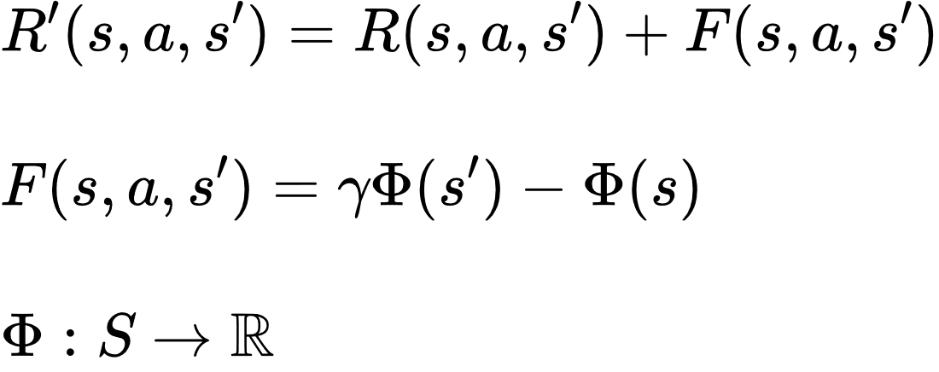
A Known Concern: Unsafe Shaping
Potential-based shaping is known to be safe*, meaning optimal policies are unchanged.
* Under some assumptions
Ng, Harada, and Stuart, 1999
Notes:
One known concern is that of unsafe shaping.
Potential-based shaping is known to be safe, meaning optimal policies are unchanged.
Ng, Andrew Y., Daishi Harada, and Stuart Russell. "Policy invariance under reward transformations: Theory and application to reward shaping." Icml. Vol. 99. 1999.

Slide 15
A Known Concern: Unsafe Shaping
Potential-based shaping is known to be safe*, meaning optimal policies are unchanged.
But trial-and-error reward shaping is typically not potential-based.
* Under some assumptions
Ng, Harada, and Stuart, 1999
Notes:
But trial-and-error reward shaping is typically not potential-based.
Ng, Andrew Y., Daishi Harada, and Stuart Russell. "Policy invariance under reward transformations: Theory and application to reward shaping." Icml. Vol. 99. 1999.

Slide 16
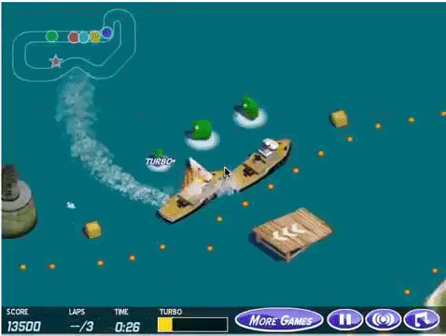
A Known Concern: Misspecification
Reward functions are often wrong and/or underspecified.
Amodei et al., 2016; Knox et al., 2021
Notes:
A second known concern is the propensity for misspecification of reward functions.
Amodei, Dario, et al. "Concrete problems in AI safety." arXiv preprint arXiv:1606.06565 (2016).
Knox, W. Bradley, et al. "Reward (mis) design for autonomous driving." Artificial Intelligence (2022): 103829.

Slide 17
A Known Concern: Misspecification
Reward functions are often wrong and/or underspecified.
Does trial-and-error reward design make this problem worse?
Amodei et al., 2016; Knox et al., 2021
Notes:
Does trial-and-error reward design make this problem worse?
Amodei, Dario, et al. "Concrete problems in AI safety." arXiv preprint arXiv:1606.06565 (2016).
Knox, W. Bradley, et al. "Reward (mis) design for autonomous driving." Artificial Intelligence (2022): 103829.

Slide 18
A New Concern: Overfitting
Notes:
We also introduce a new concern of overfitting.

Slide 19
A New Concern: Overfitting
Performance
Timesteps
_{Test Algorithm}
Notes:
Can a reward function that is effective with one algorithm …

Slide 20
A New Concern: Overfitting
Performance
Performance
Timesteps
Timesteps
_{Test Algorithm}
_{Other Algorithms}
Notes:
… be ineffective with others?

Slide 21
A New Concern: Overfitting
Can reward functions be overfit to learning algorithms and hyperparameters?
Performance
Performance
Timesteps
Timesteps
_{Test Algorithm}
_{Other Algorithms}
Notes:
In other words, can reward functions be overfit to learning algorithms and hyperparameters?
If so, how does this affect the science of reinforcement learning and what we understand about this discipline?

Slide 22
A New Concern: Overfitting
Can reward functions be overfit to learning algorithms and hyperparameters?
SPOILER: Yes
Performance
Performance
Timesteps
Timesteps
_{Test Algorithm}
_{Other Algorithms}
Notes:
Spoiler alert: yes, we find evidence of overfitting in reward design.

Slide 23
We study the implications of trial-and-error reward design.
Notes:
In this paper, we study the implications of trial-and-error reward design.
We do so empirically, with a combination of computational studies and controlled observation user studies.

Slide 24
We study the implications of trial-and-error reward design. We do so with both computational studies and controlled observation user studies.
Notes:
We do so empirically, with a combination of computational studies and controlled observation user studies.

Slide 25
On the Shoulders of Giants…
Notes:
This work is inspired by four areas of the RL research record.

Slide 26
On the Shoulders of Giants…
Optimizing Rewards for Learning
Singh 2009, Where Do Rewards Come From?
Faust 2019, Evolving Rewards to Automate Reinforcement Learning
Notes:
The first line of work we draw on assesses how reward functions can be designed and optimized to support learning.
We especially build off of Singh et al.’s paper, “Where Do Rewards Come From?”, which assessed whether rewards benefit from encoding subgoals as so-called “intrinsic motivation”.
Singh, Satinder, Richard L. Lewis, and Andrew G. Barto. "Where do rewards come from." Proceedings of the annual conference of the cognitive science society. Cognitive Science Society, 2009.
Faust, Aleksandra, Anthony Francis, and Dar Mehta. "Evolving rewards to automate reinforcement learning." arXiv preprint arXiv:1905.07628 (2019).
Amodei, Dario, et al. "Concrete problems in AI safety." arXiv preprint arXiv:1606.06565 (2016).
Knox, W. Bradley, et al. "Reward (mis) design for autonomous driving." Artificial Intelligence (2022): 103829.
Henderson, Peter, et al. "Deep reinforcement learning that matters." Proceedings of the AAAI conference on artificial intelligence. Vol. 32. No. 1. 2018.
Engstrom, Logan, et al. "Implementation matters in deep rl: A case study on ppo and trpo." International conference on learning representations. 2019.
Hadfield-Menell, Dylan, et al. "Inverse reward design." Advances in neural information processing systems 30 (2017).
He, Jerry Zhi-Yang, and Anca D. Dragan. "Assisted robust reward design." arXiv preprint arXiv:2111.09884 (2021).

Slide 27
On the Shoulders of Giants…
Optimizing Rewards for Learning
_{Reward Misdesign}
Singh 2009, Where Do Rewards Come From?
Faust 2019, Evolving Rewards to Automate Reinforcement Learning
Amodei 2016, Concrete Problems in AI Safety
Knox 2021, Reward (Mis)Design for Autonomous Driving
Notes:
The second line of work we draw on looks at the problems concerning reward misspecification.
Knox et al.’s paper “Reward (Mis) Design for Autonomous Driving” especially raises some concerns about the widespread use of trial-and-error in reward design processes.
Singh, Satinder, Richard L. Lewis, and Andrew G. Barto. "Where do rewards come from." Proceedings of the annual conference of the cognitive science society. Cognitive Science Society, 2009.
Faust, Aleksandra, Anthony Francis, and Dar Mehta. "Evolving rewards to automate reinforcement learning." arXiv preprint arXiv:1905.07628 (2019).
Amodei, Dario, et al. "Concrete problems in AI safety." arXiv preprint arXiv:1606.06565 (2016).
Knox, W. Bradley, et al. "Reward (mis) design for autonomous driving." Artificial Intelligence (2022): 103829.
Henderson, Peter, et al. "Deep reinforcement learning that matters." Proceedings of the AAAI conference on artificial intelligence. Vol. 32. No. 1. 2018.
Engstrom, Logan, et al. "Implementation matters in deep rl: A case study on ppo and trpo." International conference on learning representations. 2019.
Hadfield-Menell, Dylan, et al. "Inverse reward design." Advances in neural information processing systems 30 (2017).
He, Jerry Zhi-Yang, and Anca D. Dragan. "Assisted robust reward design." arXiv preprint arXiv:2111.09884 (2021).

Slide 28
On the Shoulders of Giants…
Optimizing Rewards for Learning
_{Reward Misdesign}
Singh 2009, Where Do Rewards Come From?
Faust 2019, Evolving Rewards to Automate Reinforcement Learning
Amodei 2016, Concrete Problems in AI Safety
Knox 2021, Reward (Mis)Design for Autonomous Driving
_{RL Reproducibility}
Henderson 2018, Deep Reinforcement Learning that Matters
Engstrom 2019, Implementation Matters in Deep RL
Notes:
The third line of work we’re inspired by is that which looks at the problems surrounding RL reproducibility.
How are the choices we make when designing our benchmarks and algorithms affecting the scientific progress of our community?
Singh, Satinder, Richard L. Lewis, and Andrew G. Barto. "Where do rewards come from." Proceedings of the annual conference of the cognitive science society. Cognitive Science Society, 2009.
Faust, Aleksandra, Anthony Francis, and Dar Mehta. "Evolving rewards to automate reinforcement learning." arXiv preprint arXiv:1905.07628 (2019).
Amodei, Dario, et al. "Concrete problems in AI safety." arXiv preprint arXiv:1606.06565 (2016).
Knox, W. Bradley, et al. "Reward (mis) design for autonomous driving." Artificial Intelligence (2022): 103829.
Henderson, Peter, et al. "Deep reinforcement learning that matters." Proceedings of the AAAI conference on artificial intelligence. Vol. 32. No. 1. 2018.
Engstrom, Logan, et al. "Implementation matters in deep rl: A case study on ppo and trpo." International conference on learning representations. 2019.
Hadfield-Menell, Dylan, et al. "Inverse reward design." Advances in neural information processing systems 30 (2017).
He, Jerry Zhi-Yang, and Anca D. Dragan. "Assisted robust reward design." arXiv preprint arXiv:2111.09884 (2021).

Slide 29
On the Shoulders of Giants…
Optimizing Rewards for Learning
_{Reward Misdesign}
Singh 2009, Where Do Rewards Come From?
Faust 2019, Evolving Rewards to Automate Reinforcement Learning
Amodei 2016, Concrete Problems in AI Safety
Knox 2021, Reward (Mis)Design for Autonomous Driving
_{RL Reproducibility}
_{Reward Function Inference}
Henderson 2018, Deep Reinforcement Learning that Matters
Engstrom 2019, Implementation Matters in Deep RL
Hadfield-Menell 2016, Inverse Reward Design
He 2021, Assisted Robust Reward Design
Notes:
Lastly, our work assumes that we ask a human to write a reward function directly. But, there are many compelling methods for smartly inferring a reward function.
Our work reinforces the importance of these efforts - and invites future research to assess how these alternative processes affect RL outcomes.
Singh, Satinder, Richard L. Lewis, and Andrew G. Barto. "Where do rewards come from." Proceedings of the annual conference of the cognitive science society. Cognitive Science Society, 2009.
Faust, Aleksandra, Anthony Francis, and Dar Mehta. "Evolving rewards to automate reinforcement learning." arXiv preprint arXiv:1905.07628 (2019).
Amodei, Dario, et al. "Concrete problems in AI safety." arXiv preprint arXiv:1606.06565 (2016).
Knox, W. Bradley, et al. "Reward (mis) design for autonomous driving." Artificial Intelligence (2022): 103829.
Henderson, Peter, et al. "Deep reinforcement learning that matters." Proceedings of the AAAI conference on artificial intelligence. Vol. 32. No. 1. 2018.
Engstrom, Logan, et al. "Implementation matters in deep rl: A case study on ppo and trpo." International conference on learning representations. 2019.
Hadfield-Menell, Dylan, et al. "Inverse reward design." Advances in neural information processing systems 30 (2017).
He, Jerry Zhi-Yang, and Anca D. Dragan. "Assisted robust reward design." arXiv preprint arXiv:2111.09884 (2021).

Slide 30
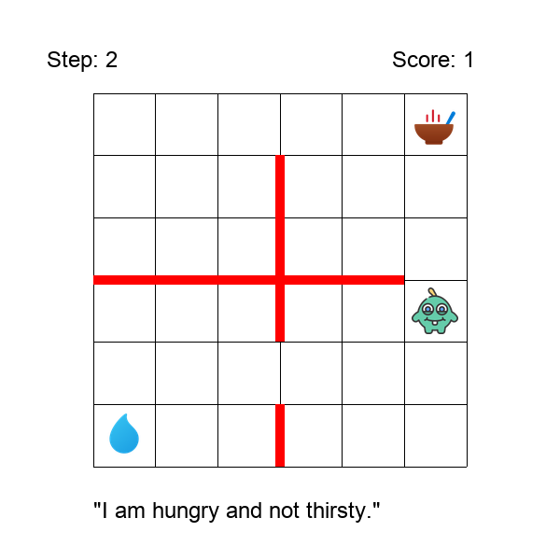
Hungry Thirsty Domain
Singh et al., 2009, Where Do Rewards Come From?
Notes:
Consider this simple gridworld task, Hungry Thirsty. It’s something you might see in an RL 101 class.
Singh, Satinder, Richard L. Lewis, and Andrew G. Barto. "Where do rewards come from." Proceedings of the annual conference of the cognitive science society. Cognitive Science Society, 2009.

Slide 31
Hungry Thirsty Domain
Food in one random corner; water in another.
Singh et al., 2009, Where Do Rewards Come From?
Notes:
Food is in one corner; water in another.
In this gridworld, the agent can only eat if it’s not thirsty.
If the agent drinks, it becomes not thirsty.
If it doesn’t drink, then it becomes thirsty with 10% probability.
The goal is for the agent to eat as much as possible.
Singh, Satinder, Richard L. Lewis, and Andrew G. Barto. "Where do rewards come from." Proceedings of the annual conference of the cognitive science society. Cognitive Science Society, 2009.

Slide 32
Hungry Thirsty Domain
Food in one random corner; water in another.
The goal is to eat as much as possible, but the agent can only eat if not thirsty.
Singh et al., 2009, Where Do Rewards Come From?
Notes:
The goal is for the agent to eat as much as possible, but the agent can only eat if it’s not thirsty.
Singh, Satinder, Richard L. Lewis, and Andrew G. Barto. "Where do rewards come from." Proceedings of the annual conference of the cognitive science society. Cognitive Science Society, 2009.

Slide 33
Hungry Thirsty Domain
Food in one random corner; water in another.
The goal is to eat as much as possible, but the agent can only eat if not thirsty.
If the agent drinks, it becomes not thirsty. If the agent doesn’t drink, it becomes thirsty with 10% probability.
Singh et al., 2009, Where Do Rewards Come From?
Notes:
If the agent drinks, it becomes not thirsty.
If it doesn’t drink, then it becomes thirsty with 10% probability.
Singh, Satinder, Richard L. Lewis, and Andrew G. Barto. "Where do rewards come from." Proceedings of the annual conference of the cognitive science society. Cognitive Science Society, 2009.

Slide 34
Hungry Thirsty Reward Functions
State consists of x-y coordinates,
hunger status (H), and thirst status (T).
Singh et al., 2009, Where Do Rewards Come From?
Notes:
The state representation consists of the agent’s x-y coordinates, as well as its Boolean hunger status and thirst status.
Singh, Satinder, Richard L. Lewis, and Andrew G. Barto. "Where do rewards come from." Proceedings of the annual conference of the cognitive science society. Cognitive Science Society, 2009.

Slide 35
Hungry Thirsty Reward Functions
State consists of x-y coordinates,
hunger status (H), and thirst status (T).
Unshaped reward function (sparse):
Singh et al., 2009, Where Do Rewards Come From?
Notes:
A candidate reward function for this environment is a sparse reward function: 1 if the agent has sated hunger, and 0 otherwise.
Singh, Satinder, Richard L. Lewis, and Andrew G. Barto. "Where do rewards come from." Proceedings of the annual conference of the cognitive science society. Cognitive Science Society, 2009.

Slide 36
Hungry Thirsty Reward Functions
State consists of x-y coordinates,
hunger status (H), and thirst status (T).
Unshaped reward function (sparse):
Unsafely shaped reward function:
Singh et al., 2009, Where Do Rewards Come From?
Notes:
But there are other reward functions which maximize the overall objective of eating as much as possible.
For example, here’s an unsafely shaped reward function which encourages the agent to learn to drink as a subgoal before learning to eat.
Singh, Satinder, Richard L. Lewis, and Andrew G. Barto. "Where do rewards come from." Proceedings of the annual conference of the cognitive science society. Cognitive Science Society, 2009.

Slide 37
Preliminaries
Define the true task performance metric:
Notes:
To introduce our experiments, we need to establish some preliminaries.
One such preliminary is the idea of a true task performance metric, which need not be Markovian.
This is a metric which is computed over trajectories to assess behaviors.

Slide 38
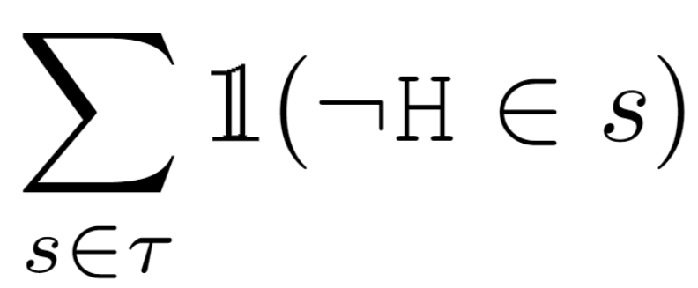
Hungry Thirsty True Performance Metric
True performance metric is the number of timesteps not hungry:
Notes:
For example, in the Hungry Thirsty domain, the goal is to eat as much as possible.
So the true task performance metric matches the sparse reward function. In each timestep when the agent has successfully eaten, the true task performance metric accumulates one point.

Slide 39
Preliminaries
Let be a distribution of learning contexts consisting of algorithms, hyperparameters, and/or environments.
Consider a sample of : .
Notes:
Let D be a distribution of learning contexts, consisting of algorithms, hyperparameters, and or environments.
Consider a sample of D, D1.

Slide 40
Preliminaries
Let be a distribution of learning contexts consisting of algorithms, hyperparameters, and/or environments.
Consider a sample of : .
We define a reward function to be overfit with respect to the sample if there exists another reward function such that:
Notes:
We define a reward function r_1 to be overfit with respect to this sample if there exists another reward function such that

Slide 41
Preliminaries
Let be a distribution of learning contexts consisting of algorithms, hyperparameters, and/or environments.
Consider a sample of : .
We define a reward function to be overfit with respect to the sample if there exists another reward function such that:
Notes:
The expected performance of a policy learned with the first reward function, r1, and learning context sample, D1, exceeds the performance of a policy learned with the different reward function

Slide 42
Preliminaries
Let be a distribution of learning contexts consisting of algorithms, hyperparameters, and/or environments.
Consider a sample of : .
We define a reward function to be overfit with respect to the sample if there exists another reward function such that:
Notes:
BUT, the expected performance of a policy learned with the first reward function, r1 IS WORSE when considering the full distribution, D.

Slide 43
A Practical Test for Overfitting
Consider a sample of : .
Consider a second distribution sample: .
Notes:
Since this definition of overfitting is intractable to test, we consider a second sample of the distribution D, D_2.

Slide 44
A Practical Test for Overfitting
Consider a sample of : .
Consider a second distribution sample: .
We define a reward function to be overfit with respect to the sample if there exists another reward function such that:
Notes:
Instead of analyzing performance over the whole distribution, we compare to the performance between these two samples to check for evidence of overfitting.

Slide 45
Computational Experiments: Setup
Tested reward functions consist of:
Where a, b, c, d ∈ [-1,1].
We test 5,196 different reward functions of this form.
a
c
b
d
Notes:
We test reward functions which consist of four values, one for each Boolean combination of the agent’s hunger and thirst status.
We test 5,196 reward functions of this form.

Slide 46
H1: Reward functions that achieve the best performance in one learning context can be suboptimal in another.
Notes:
Our first hypothesis is that reward functions that achieve the best performance in one learning context can be suboptimal in another.
This hypothesis tests whether the best reward function can be overfit, as they depend on the learning context (i.e., algorithms and hyperparameters).

Slide 47
Overfitting in Parallel Coordinate Plots
Cumulative Performance (M)
Intersections indicate overfitting.
Distribution Sample
Notes:
One tool we use for analyzing reward function overfitting is parallel coordinate plots, where we visually compare the mean cumulative performance across different learning contexts.
In a parallel coordinate plot, intersections indicate overfitting.

Slide 48
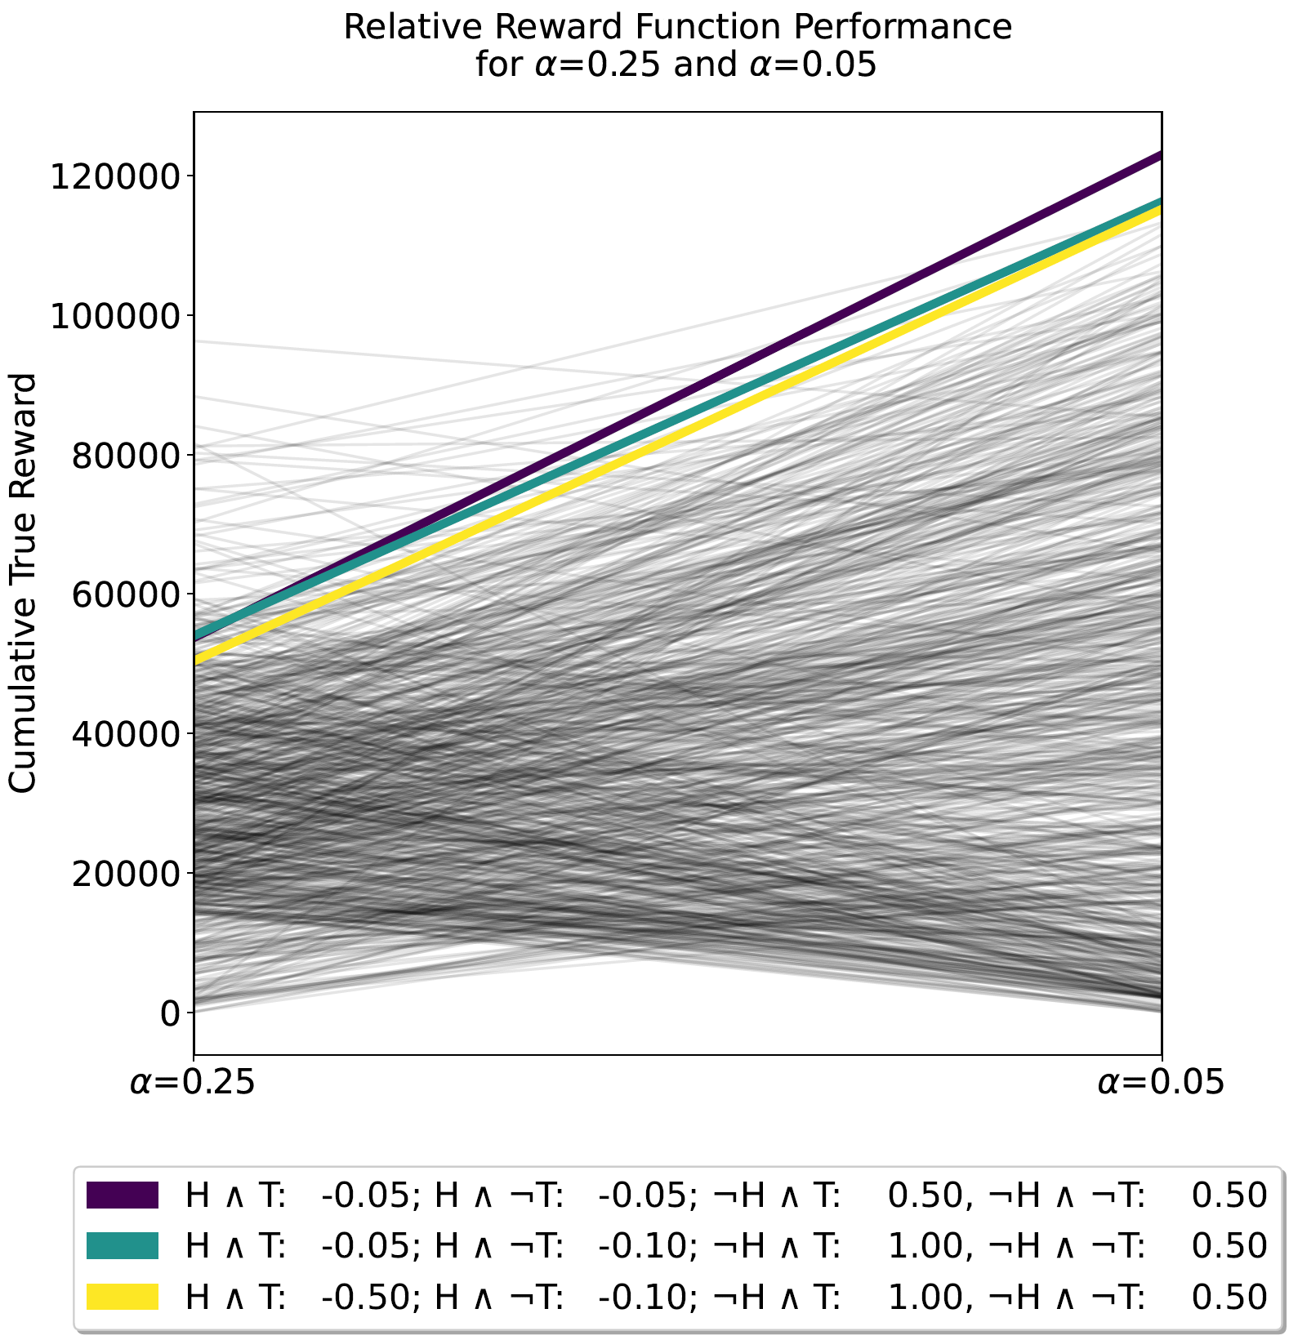
H1: Reward functions that achieve the best performance in one learning context can be suboptimal in another.
For all experiments, we find the best performing reward functions differ across learning contexts.
This is evidence of overfitting.
Notes:
For all experiments, we found that the best performing reward functions differ across learning contexts.
The best reward function changes with the hyperparameters, as shown here with the learning rate, and it changes with the choice of algorithm, too.

Slide 49
H2: The cumulative performances achieved with different reward functions are uncorrelated across different learning contexts.
Notes:
Our second hypothesis is that the cumulative performances achieved with different reward functions are uncorrelated across different learning contexts.
This tests how common reward function overfitting is. If it is a common phenomenon, correlation should be low.

Slide 50
H2: The cumulative performances achieved with different reward functions are uncorrelated across different learning contexts.
We rank all reward functions for each experiment setting ( & ).
1
1
2
Cumulative Performance (M)
2
3
3
Distribution Sample
Notes:
To test this hypothesis, we rank all reward functions for each experiment setting.

Slide 51
H2: The cumulative performances achieved with different reward functions are uncorrelated across different learning contexts.
We rank all reward functions for each experiment setting ( & ).
We compare the ordering of these rankings using Kendall’s tau.
1
1
2
Cumulative Performance (M)
2
3
3
Distribution Sample
Notes:
We then compare the ordering of these rankings using Kendall’s tau

Slide 52
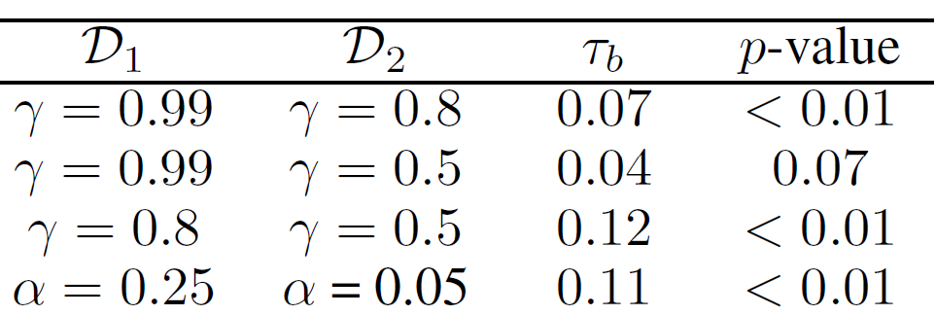
H2: The cumulative performances achieved with different reward functions are uncorrelated across different learning contexts.
We rank all reward functions for each experiment setting ( & ).
We compare the ordering of these rankings using Kendall’s tau.
We find that these rankings are uncorrelated (|tau| < 0.1)
Notes:
We find the rankings of reward function performances are either uncorrelated …

Slide 53
H2: The cumulative performances achieved with different reward functions are uncorrelated across different learning contexts.
We rank all reward functions for each experiment setting ( & ).
We compare the ordering of these rankings using Kendall’s tau.
We find that these rankings are uncorrelated (|tau| < 0.1) or slightly correlated (|tau| < 0.2).
Notes:
… or slightly correlated in all hyperparameter experiments.

Slide 54
Conclusion? Overfitting to hyperparameters (and deep RL algorithms) is a concern.
Notes:
In the results shown thus far, we used Q-learning as the underlying RL algorithm. In the paper, we also tested these hypotheses with deep RL algorithms, and similarly found evidence of overfitting.

Slide 55
Controlled Observation User Study (n=30)
Notes:
We’re now going to switch gears and talk about our controlled observation user study, with 30 RL experts.

Slide 56
User Study Conducted in Jupyter Notebooks
Notes:
Users were first tasked randomly either with designing a reward function, using sliders as shown here, allowing them to pick a value between -1 and 1 for each Boolean state combination

Slide 57
User Study Conducted in Jupyter Notebooks
Notes:
Or with picking an algorithm and its associated hyperparameters. The algorithm choices were restricted to DDQN, PPO, and A2C.

Slide 58
User Study Conducted in Jupyter Notebooks
Notes:
Though the order varied, every user ultimately designed a reward function, picked an algorithm, and selected a set of hyperparameters.

Slide 59
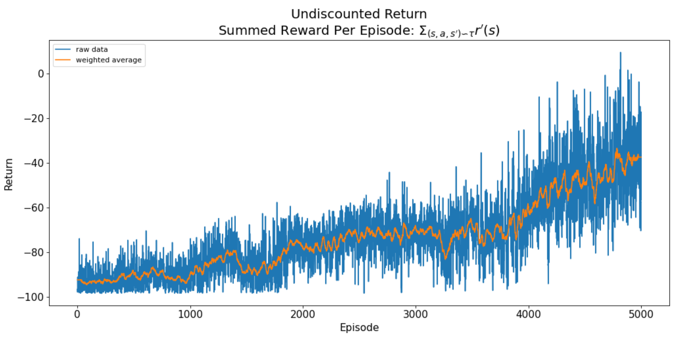
User Study Conducted in Jupyter Notebooks
Notes:
They then trained an agent and evaluated its performance, using a few different plots. One such plot consisted of the undiscounted return, which is computed with respect to their selected reward function.
Each user was instructed to train at least 3 different agents; they could go back and change their reward function, algorithm choice, or hyperparameter choices.

Slide 60
Experts Overfit Reward Functions, too
User P20 first tried a reward function which achieved M=138,092 with DDQN.
They ultimately selected a different reward function, which achieved M=1,031 with DDQN.
Notes:
We found that human subjects also overfit their reward functions.
For example, user P20 first tried a reward function which achieved a mean performance of 138,092. Their ‘final’ reward function achieved a mean performance of just 1,031 – so this user overfit their reward function.

Slide 61
Experts Overfit Reward Functions, too
User P20 first tried a reward function which achieved M=138,092 with DDQN.
They ultimately selected a different reward function, which achieved M=1,031 with DDQN.
68% of users overfit reward functions
Notes:
We found that human subjects also overfit their reward functions.
For example, user P20 first tried a reward function which achieved a mean performance of 138,092. Their ‘final’ reward function achieved a mean performance of just 1,031 – so this user overfit their reward function.
68% of users overfit their reward functions.

Slide 62
Experts are currently bad at writing reward functions.
Notes:
In addition to finding overfitting, we found evidence that people – experts – are simply bad at writing reward functions, even in simple settings like this gridworld task.

Slide 63
Experts are currently bad at writing reward functions.
_{Hard configuration}
(15 steps between water & food)
_{Easy configuration}
_{(5 steps between water & food)}
Notes:
Hungry Thirsty has some “harder” and “easier configurations”.
On the left, the food and water are located 15 steps apart – so this configuration is hard.
On the right, the food and water are only located 5 steps apart – so this configuration is easy.

Slide 64
Experts are currently bad at writing reward functions.
53% of RL experts wrote reward functions which failed to encode the task in the hard case.
_{Hard configuration}
(15 steps between water & food)
Notes:
Forget “alignment” in the real world; 53% of RL experts wrote reward functions which failed to encode the task in the hard configuration for this simple gridworld environment!

Slide 65
Experts are currently bad at writing reward functions.
53% of RL experts wrote reward functions which failed to encode the task in the hard case.
For example, P3’s reward function:
_{Hard configuration}
(15 steps between water & food)
Notes:
For example, User P3’s reward function fails to encode the task in the hard case. In this setting, the benefit of drinking (-0.1 relative to a penalty of -1 for being Hungry and Thirsty) outweighs the benefit of eating.
In the hard case, these reward functions consistently incentivize getting water too heavily.
They also tend to disregard the “cost” associated with traveling from the food to the water (almost invariably in the Hungry and Thirsty state).

Slide 66
Most experts (83%) use
a myopic design strategy.
Notes:
We found that most – 83% -- of experts use a myopic design strategy of weighing state goodness to design their reward functions.

Slide 67
“It’s best to not be hungry and thirsty, so I’ll set that to the max, 1. Being not thirsty is better than being not hungry. Worst is at hungry AND thirsty; setting that to -1”
-P25
Notes:
For example, P25 stated:
“It’s best to not hungry and not thirsty, so I’ll set that to the max, 1. Being not thirsty is better than being not hungry. Worst is at hungry AND thirsty; setting that to -1”.
This myopic strategy focuses on the relative goodness of individual states, and it does not align with the RL optimization objective of maximizing expected discounted return. This strategy often leads to misdesigned reward functions, as it did for user P25.

Slide 68
People are bad at reasoning
about reward accumulation.
Notes:
From qualitatively analyzing expert’s comments, we particularly believe that people are bad at reasoning about reward accumulation, and especially temporal discounting.
This is interesting, because it provides insight on how we might think about supporting people in designing better reward functions.
We need to think about how we can support people in reasoning about temporal discounting.

Slide 69
Takeaways
Reward functions can be overfit to learning algorithms.
Notes:
One takeaway is that reward functions can be overfit to learning algorithms and contexts. This has implications for reproducibility in RL, and this means we must even more carefully and critically evaluate research contributions.

Slide 70
Takeaways
Reward functions can be overfit to learning algorithms.
Practitioners should construct two reward functions: one for learning and one for evaluating.
Notes:
One takeaway for practitioners is that they should consider constructing two reward functions, particularly when shaping or conducting trial and error reward design. One of these reward functions should be used strictly for learning – trying to support the fastest and best learning possible – and the other should be used for evaluation, to facilitate comparisons across algorithms and learning contexts.

Slide 71
Takeaways
Reward functions can be overfit to learning algorithms.
Practitioners should construct two reward functions: one for learning and one for evaluating.
We should work to support human reward designers by aligning reward design & the RL objective.
Notes:
And lastly, we should work to support human reward designers by finding mechanisms to align the process of reward design and the RL objective of maximizing expected discounted return.

Slide 72
Limitations & Future Work
Only tested with one domain!
Notes:
The main limitation of this work is that we only tested with one domain. While this domain has significant richness, it’s clearly not representative of all RL settings – so expanding this work to look at other domains is one compelling direction.

Slide 73
Limitations & Future Work
Only tested with one domain!
Can alternative models of reward help?
Notes:
Second, can alternative models of reward or reward inference help? Can we support humans in doing a better job of designing reward functions?

Slide 74
Limitations & Future Work
Only tested with one domain!
Can alternative models of reward help?
How has overfitting affected the research record?
Notes:
Lastly, how has overfitting affected the research record? Where should we as a community focus our efforts, as we yet again reconsider issues of reproducibility and comparison in our efforts?

Slide 75
The Perils of Trial-and-Error Reward Design
Serena Booth
Brad Knox
Julie Shah
Scott Niekum
Peter Stone
Alessandro Allievi
Code: github.com/serenabooth/reward-design-perils Contact: sbooth@mit.edu
AAAI 2023
Notes:
Hello, I’m Serena Booth, and I’m presenting our AAAI 2023 paper: “The Perils of Trial-and-Error Reward Design: Misdesign Through Overfitting and Invalid Task Specifications”

